Slide 1

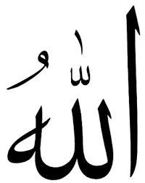
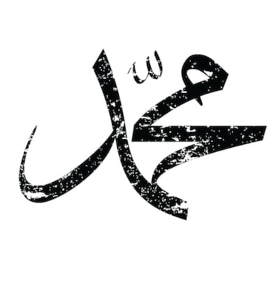
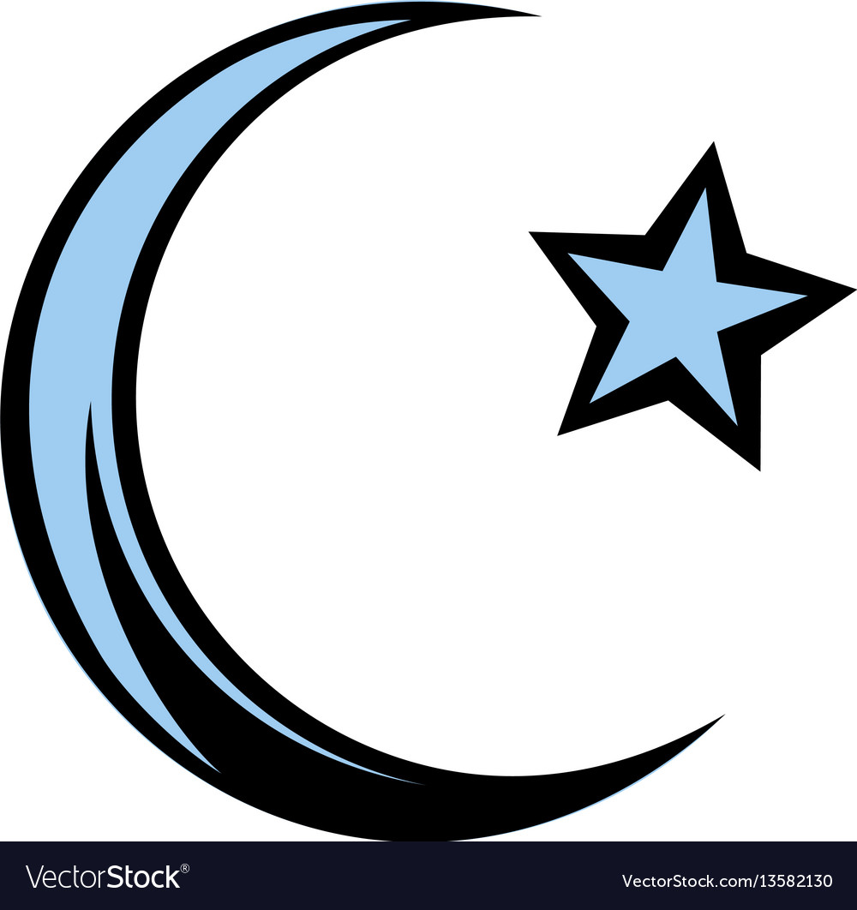
Allah
Books
Messengers
Last Day
Angels
Resurrection
Qadr
رب العالمين -مالك يوم الدين
عالم الغيب و الشهادة
شاهدا و مبشرا و نذيرا
الَّذِينَ يُؤْمِنُونَ بِالْغَيْبِ
- وَبِالْآخِرَةِ هُمْ يُوقِنُونَ

Slide 2
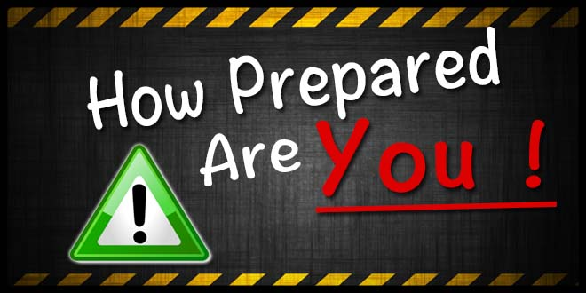
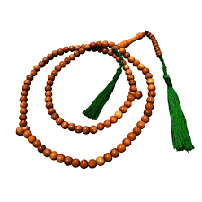
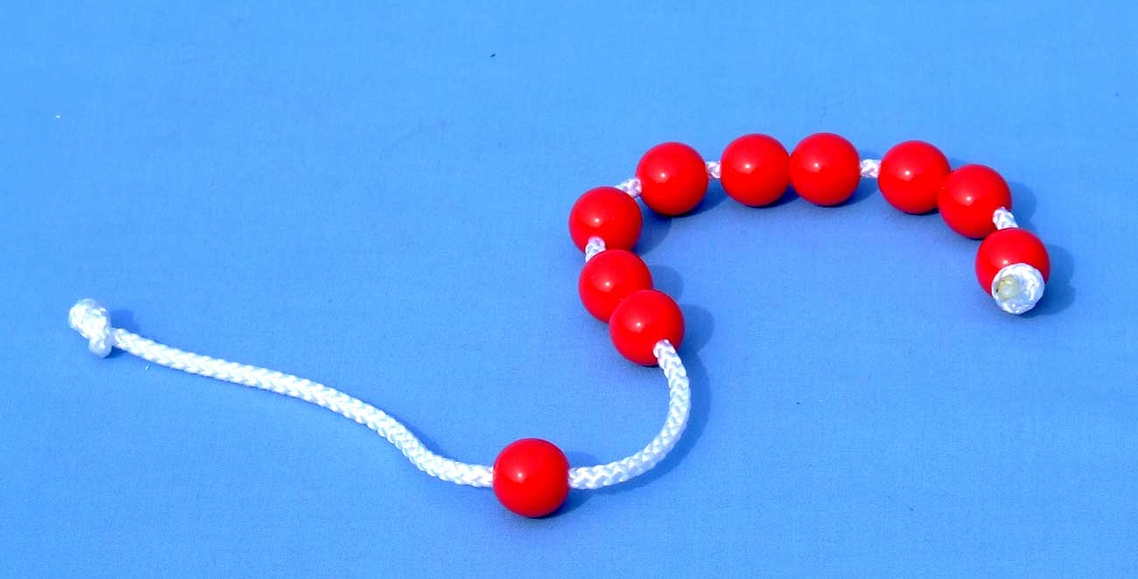
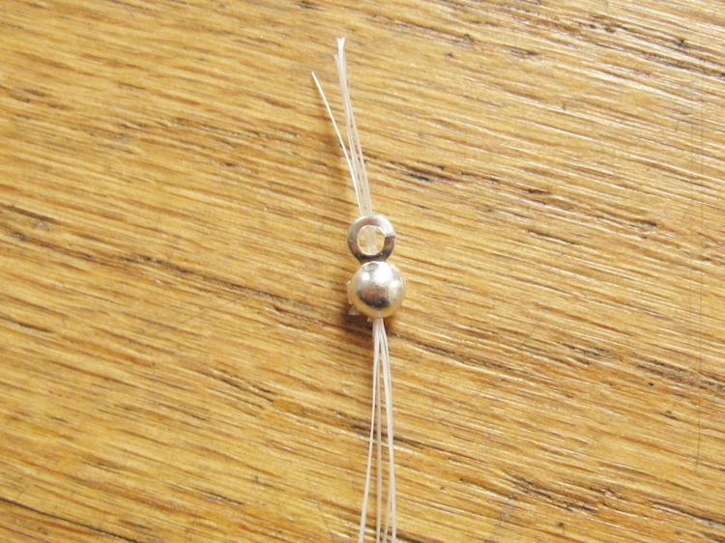
“WHEN IS THE LAST HOUR?
WHAT HAVE YOU PREPARED FOR IT?”
“PLANT A SEED
EVEN IF THE HOUR IS ABOVE YOU”
“There will always be a migration, nation after nation, generation after generation of the true believers, who will never ever stop until the end of time.”
What are you waiting for? Who will you be with? What will you prepare?
Notes:
Able to do good deed – do it. There is always a point.
Never despair or give up hope. Quds has been destined by Allah from beginning to end of time no matter what happens, people, believers will come back again and again.
The Prophet gave a visual way – the beads inside the string – one will come after the other

Slide 3
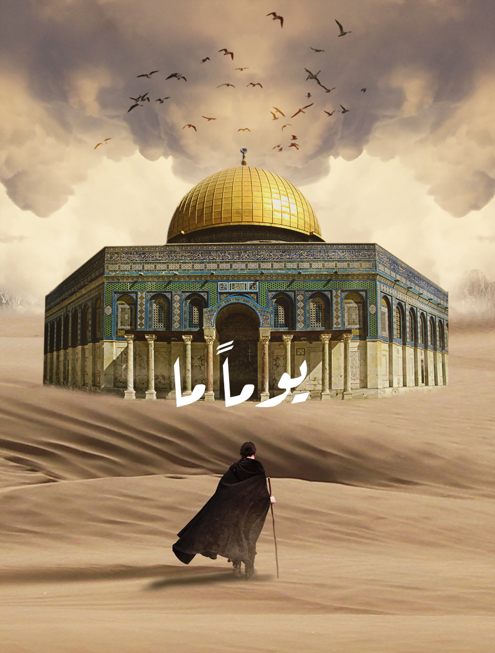
Believers will gather in Quds, Jordan, Lebanon, Syria & Turkey - Khalifate will return in Palestine
فَإِذَا جَاءَ وَعْدُ الْآخِرَةِ لِيَسُوءُوا وُجُوهَكُمْ وَلِيَدْخُلُوا الْمَسْجِدَ كَمَا دَخَلُوهُ أَوَّلَ مَرَّةٍ وَلِيُتَبِّرُوا مَا عَلَوْا تَتْبِيرًا
So when the second promise came (We raised another people) that they may bring you to grief and that they may enter the mosque as they entered it the first time, and that they might destroy whatever they gained ascendancy over with utter destruction. (17:7)
MUSNAD AHMAD - 5 LEADERSHIPS IN HUMANITY
1. Prophethood – Muhammad
2. Khilafah Raashidah –Umar ibn Abdil Azeez
3. Monarchies - Abbasids Umayyads Ottoman
4. Tyrannical Despotism Dictatorship Turmoils
5. Khilafah Raashidah will re-emerge
Notes:
وَعَدَ اللَّهُ الَّذِينَ آمَنُوا مِنكُمْ وَعَمِلُوا الصَّالِحَاتِ لَيَسْتَخْلِفَنَّهُمْ فِي الْأَرْضِ كَمَا اسْتَخْلَفَ الَّذِينَ مِن قَبْلِهِمْ وَلَيُمَكِّنَنَّ لَهُمْ دِينَهُمُ الَّذِي ارْتَضَىٰ لَهُمْ وَلَيُبَدِّلَنَّهُم مِّن بَعْدِ خَوْفِهِمْ أَمْنًا يَعْبُدُونَنِي لَا يُشْرِكُونَ بِي شَيْئًا وَمَن كَفَرَ بَعْدَ ذَٰلِكَ فَأُولَٰئِكَ هُمُ الْفَاسِقُونَ
Allah has promised those who have believed among you and done righteous deeds that He will surely grant them succession [to authority] upon the earth just as He granted it to those before them and that He will surely establish for them [therein] their religion which He has preferred for them and that He will surely substitute for them, after their fear, security, [for] they worship Me, not associating anything with Me. But whoever disbelieves after that - then those are the defiantly disobedient.

Slide 4

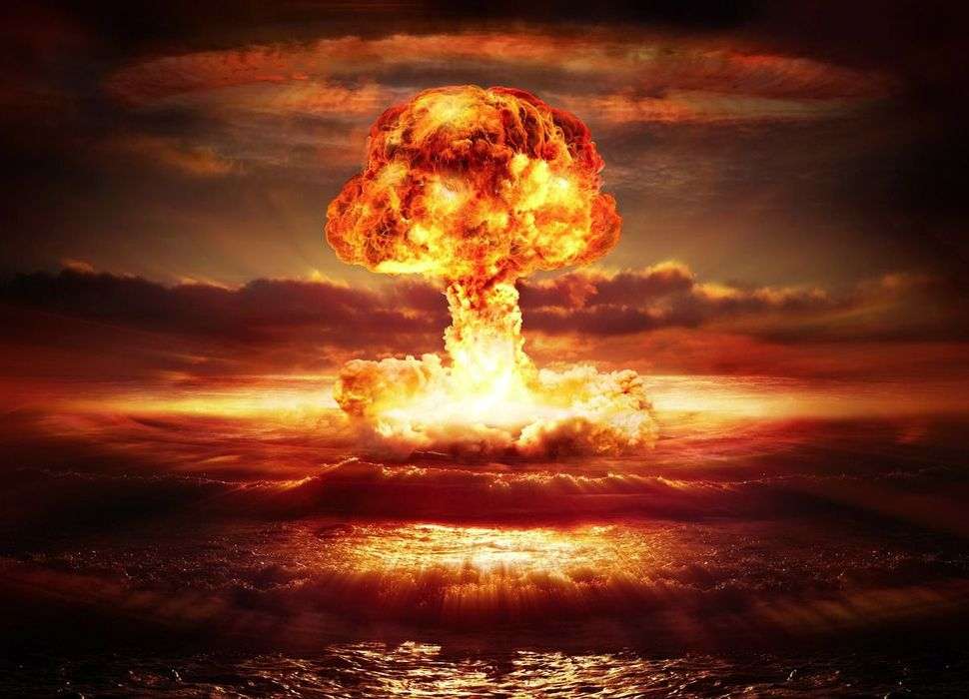
تُصالحون الروم
“Romans will enter a peace treaty with you – you and they will fight together the enemy. You will be victorious collect spoils of war be safe and come back until you stop in a meadow with many hillocks. A man will raise the cross and say the cross has prevailed, then a man amongst the Muslims will be angry and go and break the cross – then the romans will prove treacherous and break the treaty and gather for a fierce battle.”
THIS IS YET TO COME
“Then the Romans will have a fierce battle – so intense – that you will see the flying object falling from the sky.”
A group of Muslims will come from Madinah to help. Romans will meet them at a certain place near Shaam - 3rd will run away, 3rd will die as Shaheed - 3rd will be victorious.
The Muslim will take Constantinople in peace – then the Dajjal will emerge
Notes:
This indicates – Mahdi – the rightly guided leader – could be general or commander or khalifah and lead the Muslims?

Slide 5
Imam Mahdi – The Guided Leader
Muhammad son of Abdullah - direct lineage from Fatimah – Ali - Prophet
He will have a white forehead and thin nose
Fill the world with justice just as it was filled with injustice
Rule as a righteous Khalifah for 7 years in peace
Lots of vegetation & plant growth & wealth - economic stability & equality
Mahdi will NOT know he is the Mahdi – he will be going from Madinah to Makkah
Arrive in Makkah - army will be following him from the East, wanting to kill him
Earth will swallow them up when they reach the plain lands - Madinah
Everyone will realise he is the Mahdi
UNTIL THAT TIME – WE NEED TO CONTINUE TO STRIVE AND DO OUR PART
Notes:
Mahdi - Dajjal not mentioned in Qur’an – Ummah should not focus on Mahdi or Dajjal or Esa
Qur’an addresses what we need to do NOW
Right now living in time of false influence lies, Dajal – not the Dajjal himself

Slide 6
Eesa Ibn Maryam – Maseeh As-Saadiq
“O how your state will be, when the son of Maryam will descend upon you while your Imam will be among you”
Redish white complexion – long silky hair - handsome
Jesus Christ will appear at the white minaret east of Damascus
His hands on top of two angels. His hair will look wet
When he lifts his head pearl like droplets fall
“The hour will not come until the Messiah son of Mary will come until he descend and kills the pig, breaks the cross and establishes justice”
He returns peoples morality and true values
He comes as a follower of Islam & Imam Mahdi
Eesa emerges just after Dajjal appears on earth
The fight will happen at Jerusalem with Mahdi leading the army of the believers
Notes:
كيف انتم إذا نزل عيس ابن مريم
The hour will not begin until the Muslims fight the jews – kill them until a jew hides behind a rock or tree - the tree or rock will say o Muslim there is a jew behind me come and kill me except the Gharqad – a thorny type of tree, a tree of the jews, it will not speak

Slide 7
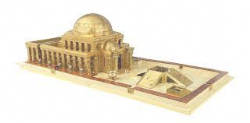
Jews believe the Messiah will return - waiting for him – build 3rd temple – Rule the world
1st two were destroyed by the Romans and Babylonians
Ultra orthodox jews don’t come into Jerusalem, they are waiting the return of the Messiah
Political Zionist – Religious Zionist - Christian Zionist
Want a state of Israel for the return of the Messiah/Jesus - Thus they support it

Slide 8
Eesa  - True Messiah - after he descends, will enter the Masjid in Jerusalem
What does that mean? No more authority/control Jews?!
The Khilaafah will be in Palestine - Jerusalem will be the capital
Eesa  will enter the Masjid – he will see Imam Mahdi
Imam Mahdi will move back from the Salah and tell him to pray/lead the Salah
Eesa  “No, stay - for every nation God has blessed with their own leaders”
Eesa  will pray behind Imam Mahdi and follow Islam/ sunnah of Muhammad 
By Allah, if Musa was here with me today, he will not do anything except follow me
وَإِنَّهُ لَعِلْمٌ لِّلسَّاعَةِ فَلَا تَمْتَرُنَّ بِهَا وَاتَّبِعُون
هَٰذَا صِرَاطٌ مُّسْتَقِيمٌ
“And indeed, Jesus (second) coming will be a sign for knowledge of the Hour, so be not in doubt of it, and follow Me. This is a straight path.” (43:61)
Notes:
و الذي نفسي بيدي

Slide 9
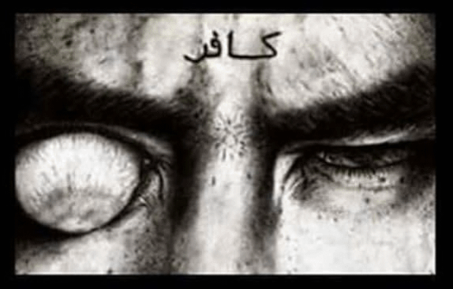
The Dajjal – The Lying False Messiah
He will say I am the Messiah
He will say I am the Saviour
He will say I am god
People will believe, follow 7 worship him
He will travel the entire earth & enter every city. He will live 40 days; a day like a year, a day like a month, a day like a week and the remaining days will be like your days.”
Dajjal will come from the East with 70,000 Jews of Asfahan - thinking he is the messiah
Majority of his followers will be Jews
Jews, Christian & Others will go with him to rebuild the 3rd temple of Solomon
اللَّهُمَّ إِنِّي أَعُوذُ بِكَ مِنْ عَذَابِ الْقَبْرِ، وَمِنْ عَذَابِ جَهَنَّمَ، وَمِنْ فِتْنَةِ الْمَحْيَا وَالْمَمَاتِ، وَمِنْ شَرِّ فِتْنَةِ الْمَسِيحِ الدَّجَّالِ
Notes:
Living in times of Fitna/Dajal confusion – deception – Mamsuh defective eye
Before the coming of the Dajjal – Years of betrayal and lies - Years of Khada’aat – deception – tricky betray – يصدق فيه الكاذب – the one who is a liar is believed, the honest is called a liar.
The betrayer is given trust authority leadership - Rubaybidah – ignorant foul mouthed speak without knowledge harsh hearted insolent they are spokes people
Someone might think, so much information about Dajal, surely Muslims won’t follow him. Alcohol, Zina, Riba, but people do it.
It’s not whether you can recognise, but whether you can resist him.

Slide 10
He will travel like rain that is driven by wind
He will approach a community and invite them [to accept his divinity] and they will believe in him and respond to his call
He will then order the sky [to rain] and consequently it will rain
He will give an order to the earth and it will bring forth produce
He will then go to [another] community and invite them however they will reject his claim [to divinity]. He will then leave them and they will [end up] being afflicted with drought. All of their wealth will be gone from their hands
He will pass by a land in ruins and say to it, “Bring forth your treasures.” its treasures will come out and follow him like a swarm of bees. Then he will call a man brimming with youth and strike him with a sword. He will cut him in two pieces and place each piece as far from each other as a target from an archer. He will then summon him and he will come forth with his face gleaming and laughing
Notes:
Khurasan - Jews of Isfahan,

Slide 11
No greater calamity than Dajjal upon my ummah
He will convince people with his word & actions
He will make you doubt & leave your faith
A person wake up believer in morning; disbeliever in evening
They will sell their religion for a few material gains of the world
Short young man, ruddy complexion, thick curly hair, wide forehead, broad upper chest, legs wide apart similar to rickets. Right eye with be cloudy grey cataract, blind/defective – look like a floating grape.
Left eye has a little piece of meat that comes out from the side towards the nose. On his forehead will be the letter K F R ك ف ر– ever literate and illtreat true Muslim will be able to see and read it.
He will eat, drink and sleep
He will be sterile, with no children born to him
Notes:
The root dajala means to mix. The word dajala is used to mean deliberately confusing matters and being vague and ambiguous, The Dajjal is the one who speaks in vagaries, who tells many lies and deceives many people.

Slide 12
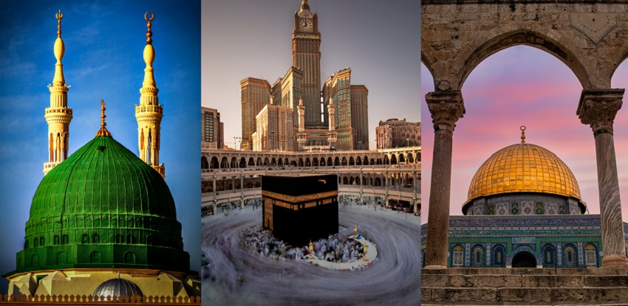
Dajjal will never be able to Enter Madinah, Makkah or Al-Aqsa
The Angels will be guarding it with their swords unsheathed
Dajjal will stand outside Madinah, all hypocrites will come out and follow him.
Large number of jews disbelievers and Christians will follow him to Al-Quds

Slide 13
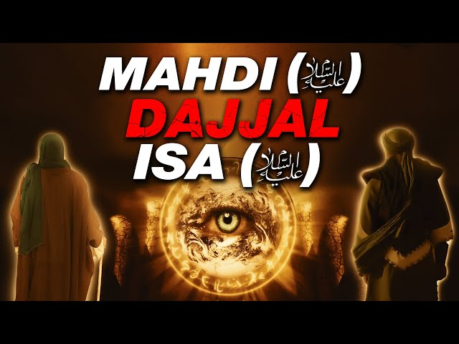
Esa  will already be with the Muslims in Jerusalem
Esa  will open the gate of Jerusalem and the Dajjal will be waiting behind the door thinking he’s about to enter with his followers
As soon as Dajjal sees Esa , he runs away and he start to melt
Esa  runs after him and takes his weapon and kills Dajjal
Esa  shows the sword/weapon to his followers and says if he was god why would he bleed?

Slide 14
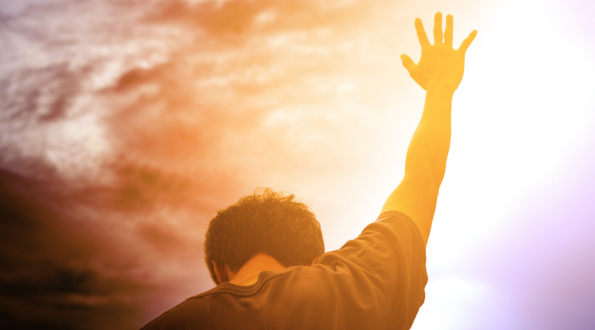
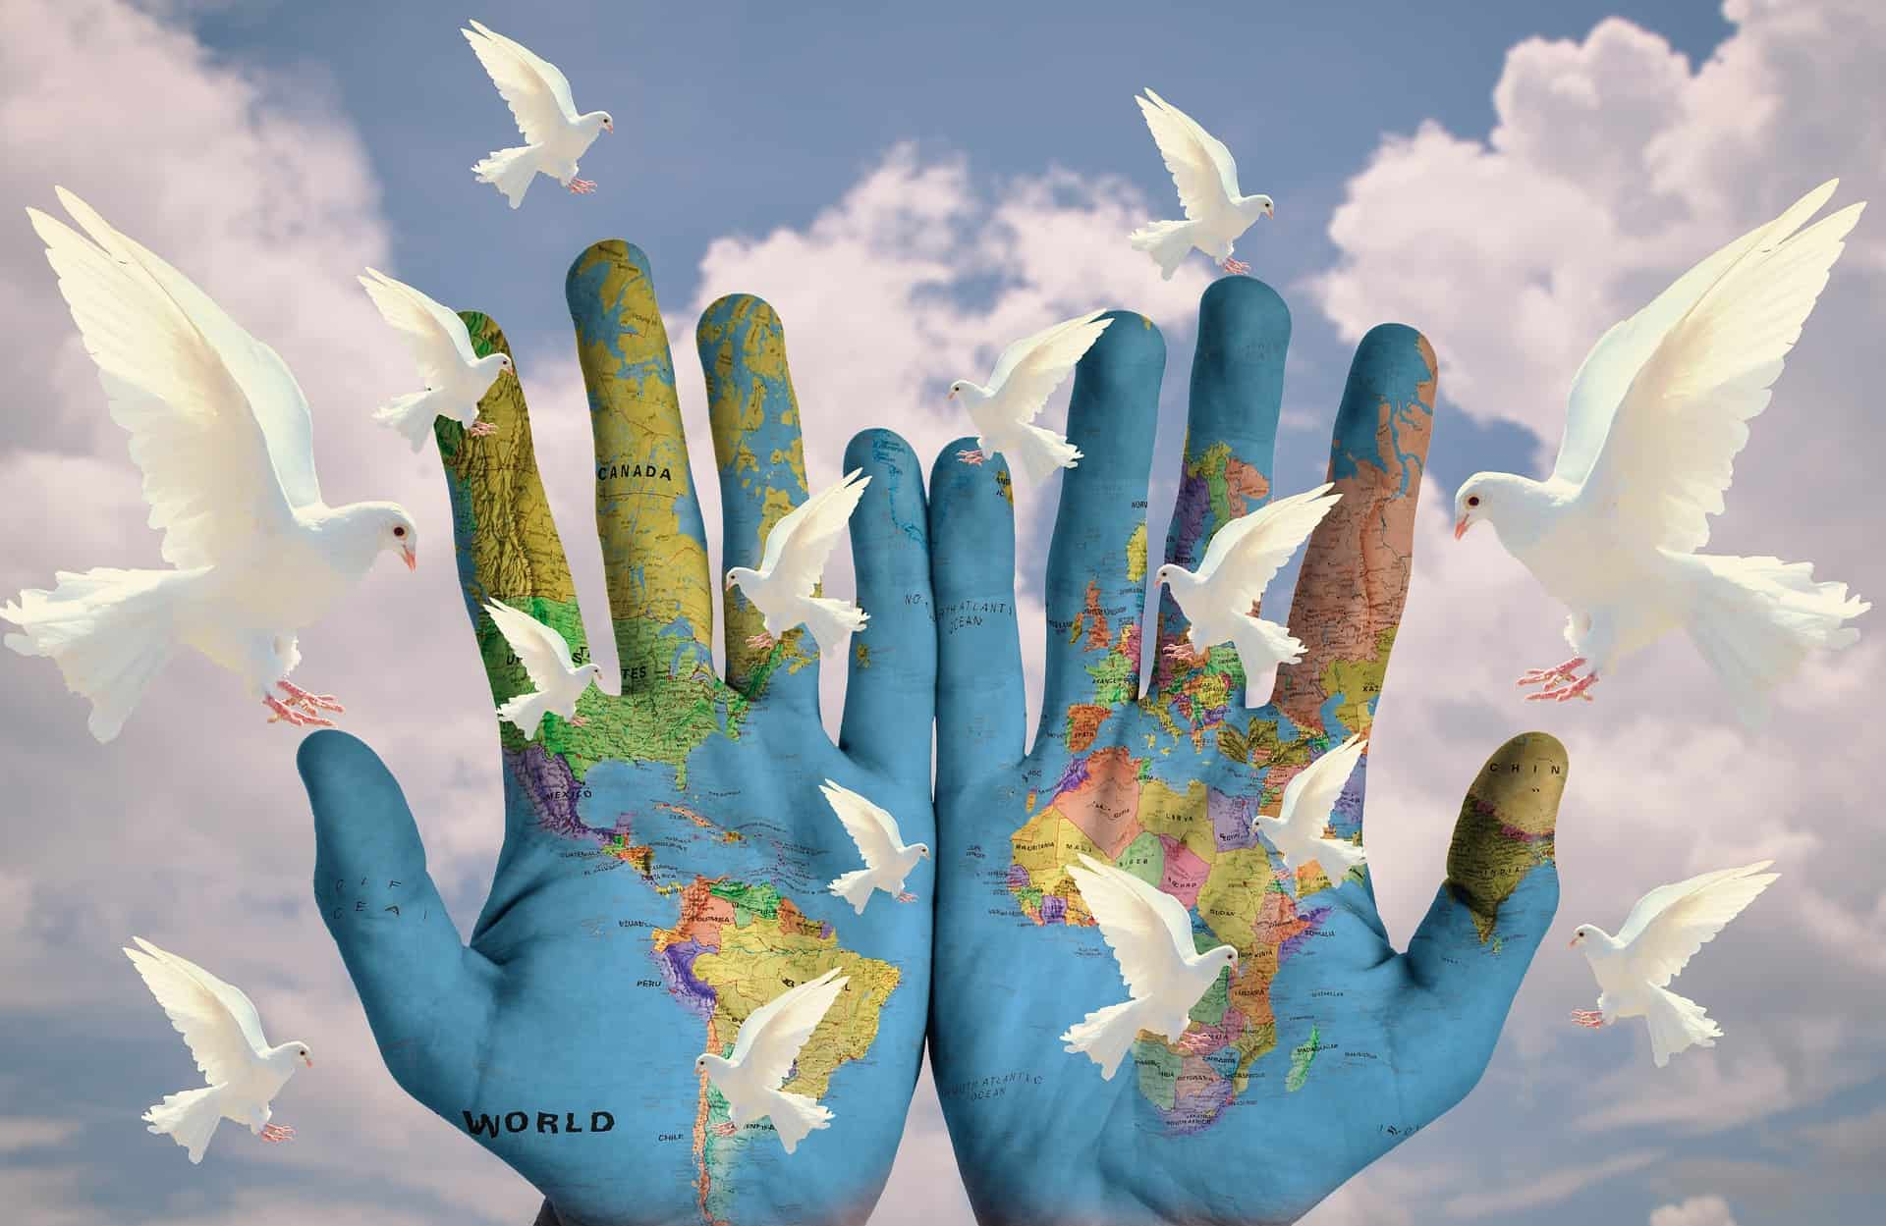
The Christian’s repent and follow the True Messiah
The battle will be over
After this final battle - there will be years of:
PEACE – JUSTICE - GOODNESS & PROSPERITY
Islamic Rule under Imam Mahdi for 7 years
Wealth
Economic Stability
Equality
No Poverty
No Tax
Jizya Abolished
Faithful Muslims – Tidings Jannah
Notes:
Imam Mahdi and Esa will travel the world and meet all those who refuced to believe in Dajjal – Glad tidings

Slide 15
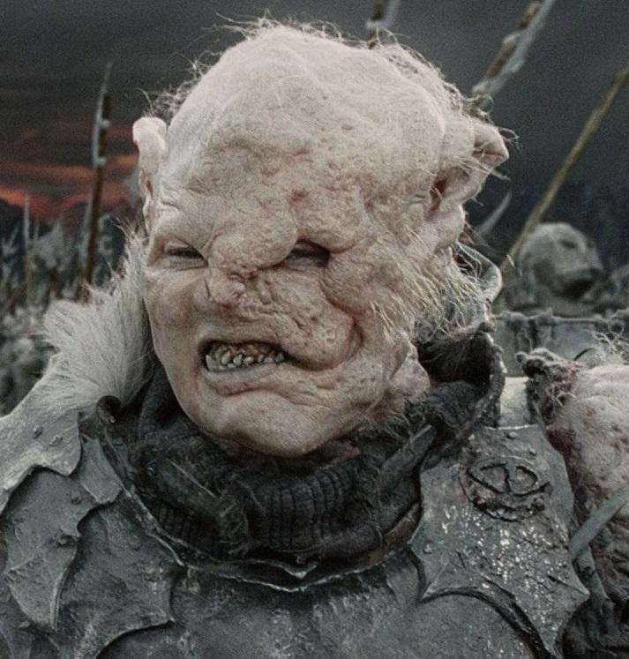
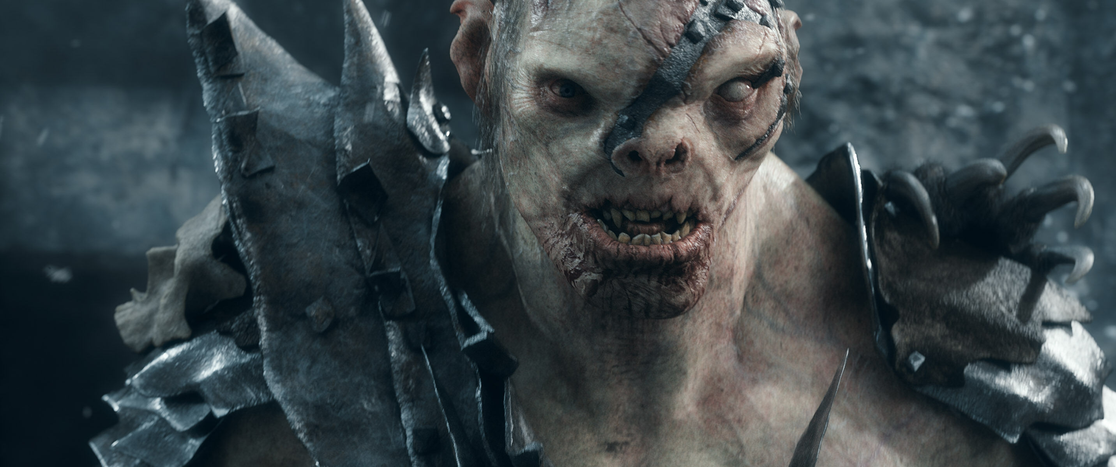
Eesa  will break the cross, kill the pig, remove Jizyah.
So much peace & safety that lions will graze with camels, leopards with cows and wolves with sheep. A child will play with snakes, yet they will not harm him.
Then Allah  will inform Eesa  that Ya’jooj and Ma’jooj have arrived
They will spread all over the world & cause utter havoc and destruction
They will descend from every slope
The first of them will pass by the Sea of Tiberius [located in the Jordan Great Rift Valley] and drink all its water. [When] the last of them will pass [by it] they will say, “There was once water here.

Slide 16
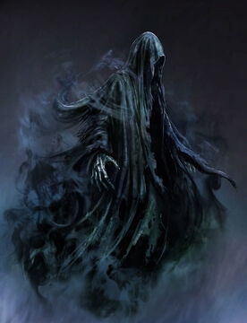
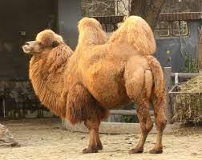
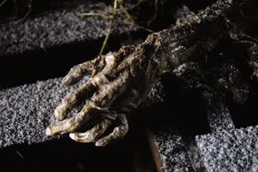
Eesa  & his companions will besiege Ya’jooj and Ma’jooj
Eesa  & his companions will pray to Allah 
Allah  will send worms in their necks
As a result they will die all at the same time
Eesa  & his companions will then descend to the ground and will not find even the space of a hand span that will not be filled with their decayed [bodies] & stench
Eesa  & his companions then pray and Allah  will send birds that will resemble the necks of Bactrian Camels. The birds will carry [their bodies] away and throw them away
Allah  will send such rain that no mud house or hut will be sheltered from it. It will cleanse the earth until it leaves it like a mirror. The earth will then be told, “Bring forth your fruits and restore your blessings”

Slide 17
10 MAJOR SIGNS LEADING TO LAST HOUR
Earth Sinks - Swallows - East
Earth Sinks - Swallows - West
Earth Sinks - Swallows - Arabia
The Smoke – Covering Earth
Mahdi – Dajjal – Esa
Ya’jooj and Ma’jooj
Beast of Earth - Speak to people - divide people of paradise and hellfire
Supernatural fire in Yemen
Drive people to place of judgement
Rising sun in west
An Ethiopian king will come and destroy the Ka’ba brick by brick. No Muslims to protect it
People will then again worship Laat and Uzzah – gods of pagan arabs
Allah will send a final breeze – every believer on earth dies peacefully
World will end with those that are left. Then Isarefel will blow the trumpet

Slide 18
PAST SIGNS:
• The Prophethood of Muhammad 
• The splitting of the Moon
• The death of the Prophet Muhammad 
• A form of death, which will kill thousands of Muslims. (Understood to refer to the plague of Amwas during the caliphate of 'Umar Ibn Al-Khattab 
• A major fighting in Madinah (understood to refer to the battle of Al-Harrah 63 AH)
• A great fire in the Hijaz (in Saudi Arabia), this took place in 654
• The Muslim conquest of Jerusalem in 1187 AD
• The Muslim conquest of Constantinople in 1453 AD
• Two large groups of Muslims fighting in war
• A war between the Muslims and a reddish people with small eyes, wearing sandals made of hair (understood to refer to the Mongol Tatar invasion of the Islamic lands)
• A peace agreement between the Muslims and non-Muslims from the yellow race
• Thirty impostors will appear, each one claiming to be a prophet

Slide 19
PRESENT SIGNS:
• Naked, destitute, barefoot shepherds will compete in building high buildings
• The slave-woman will give birth to her master or mistress (this refers to children disrespecting their mothers)
• A tribulation which will enter every Arab household (this may refer to TVs, satellite dishes and the internet-when misused)
• Knowledge will be taken away (by the death of scholars), and ignorance will prevail
• Wine (intoxicants, alcohol) will be drunk in great quantities
• Illegal sexual intercourse will become widespread
• Earthquakes will increase
• Time will pass more quickly
• Tribulations will prevail
• Bloodshed will increase
• A man will pass by the grave of another and wish he was in the latter's place
• Trustworthiness will be lost, authority is given to those who do not deserve it
• People will gather for prayer, but will be unable to find an Imam to lead them
• Voices will be raised in the Masjid

Slide 20
FUTURE SIGNS:
• The number of men will decrease, whilst the number of women will increase, until each 50 women will be looked after by one man
• The Euphrates will reveal a treasure of gold, and many will die fighting over it, each one hoping to be the one who gains the treasure
• The Romans (Europeans) will come to a place called A'maq or Wabiq, and an army of the best people will go forth from Madinah to face them
• The Muslim conquest of Rome
• The Mahdi (guided one) will appear, and be the leader of the Muslims. Eesa  will descend in Damascus, and pray behind Imam Mahdi
• Eesa  will break the cross and kill the swine, i.e. destroy the false Christianity
• The Antichrist will appear, with all his tools of deception, and be an immense trial. He will be followed by 70,000 Jews from Isfahan (present-day Iran)
• The appearance of Gog and Magog, and the associated tribulations
• The emergence of the Beast who will speak to the people
• The day where the sun will rise from the west

Slide 21
• A major war between the Muslims led by the Leader Al-Mahdi, and the Jews plus other non-Muslims led by the Antichrist
• Jesus will kill the Antichrist at the gate of Ludd
• A time of great peace and serenity during and after the remaining lifetime of Jesus
• Wealth will come so abundant – no one will be eligible for Zakah
• The Arabian Peninsula will become a land of gardens and rivers
• Society will then decay
• The buttocks of the women of the tribe of Daws will again sway in circumambulating (Tawaf) around the idol Thul-Khulasah
• A gentle wind, which will take the souls of the believers
• There is no one left on the earth saying, "Allah, Allah" or "There is no god except Allah."
• Eventually the Day of Judgment is established upon the worst of the people, who copulate in public like donkeys
• The blowing in the Trumpet by the Angel Israfeel upon which everyone will die
• The second blowing in the Trumpet, upon which everyone will be resurrected

