Slide 1

Palestine
Why/How

Slide 2







When all of this started
What did you do?
Where did you go?
Who did you follow?
Who are you believing?
Tik Tok - Instagram - YouTube - Facebook
BBC – CNN - Al-Jazeera - UAE
Piers Morgan - Tzipi Hotovely
Muhammad Hijab - Bassem Youssef
UN – USA – UAE – Labour – Tories?
Notes:
You are what you consume
Light or darkness
You reflect what you embody

Slide 3
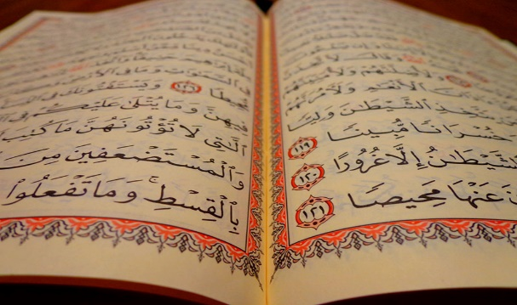
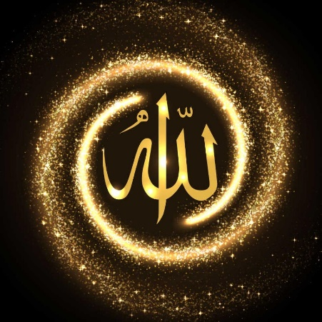
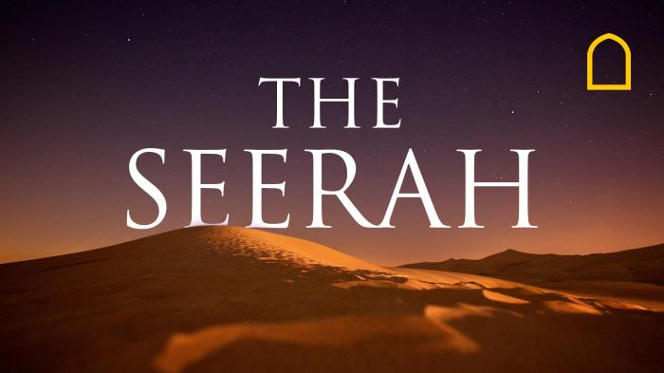
Who turned to the Qur’an?
Who asked Allah  what/why is this happening?
Who opened up the stories of Musa/Firawn?
Who read the verses of the Muslim community?
Who read the Seerah and learnt from the Battles?
Who realised that this is history repeating itself?
Who realised that this is the promise of Allah  coming true?
Who realised this is a test for us and them?
Talk to Allah, Listen to Allah, Believe Allah, Follow His Messenger!
Notes:
Have you started tajahhud, fajr, isha? Increased in daily Quran Arabic and English?
Read the Seerah and Qur’anic stories? Stopped lying, cheating, haram, interest, backbiting, fraud?
Have you increased in dua, patience, are you back on the path?
They haven’t stopped – Gazan’s – They’ve increased! Have you?

Slide 4
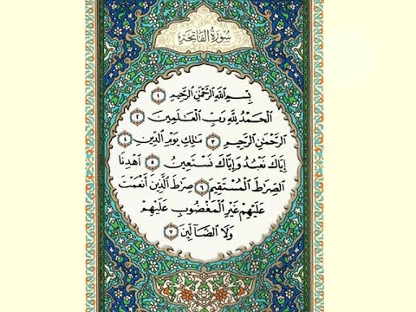
Why Ya Allah? Where is Allah? His Mercy? His Protection? Why is This Happening?
“In the name of Allah, most benevolent, gracious, ever-merciful, entirely, especially, compassionate, dispenser of grace
All praise be to Allah, Sustainer, Lord of all the worlds, universe, being, existence
Most Beneficent, Gracious, Ever-merciful, Compassionate
Sovereign, Master, Owner, Judge, King, Lord of the Day of Judgement, Recompense, Doom, Requital, Retribution
You alone we worship, and to You alone turn, beseech, implore for help, seek aid
Keep, Show, Direct, Guide to, on, in, the path, straight way
The path of those You have blessed, favoured, Not of those who earned, evoked Your anger, wrath, condemned, indignation, gone astray, misguided”

Slide 5
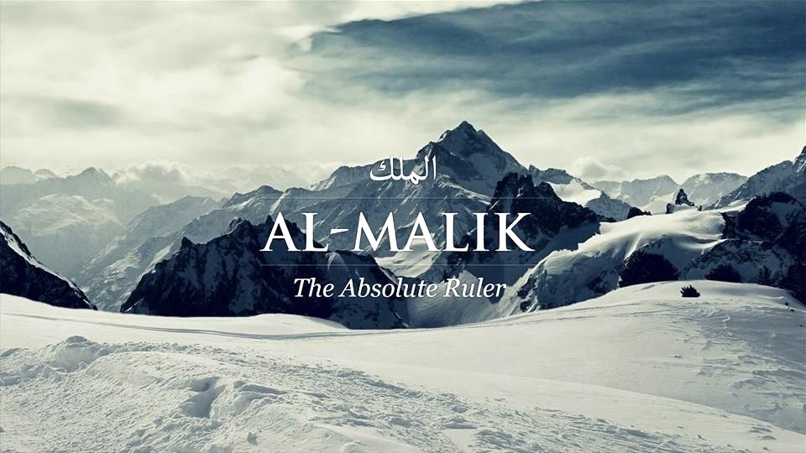
“Blessed be He who holds the (reins of) kingship in His hand, who has power over everything
He who created death and life in order to try you to see who of you are best of deed
He is all-mighty and forgiving” (67:1-2)
Notes:
تَبَارَكَ الَّذِي بِيَدِهِ الْمُلْكُ وَهُوَ عَلَىٰ كُلِّ شَيْءٍ قَدِيرٌ الَّذِي خَلَقَ الْمَوْتَ وَالْحَيَاةَ لِيَبْلُوَكُمْ أَيُّكُمْ أَحْسَنُ عَمَلًا وَهُوَ الْعَزِيزُ الْغَفُورُ

Slide 6
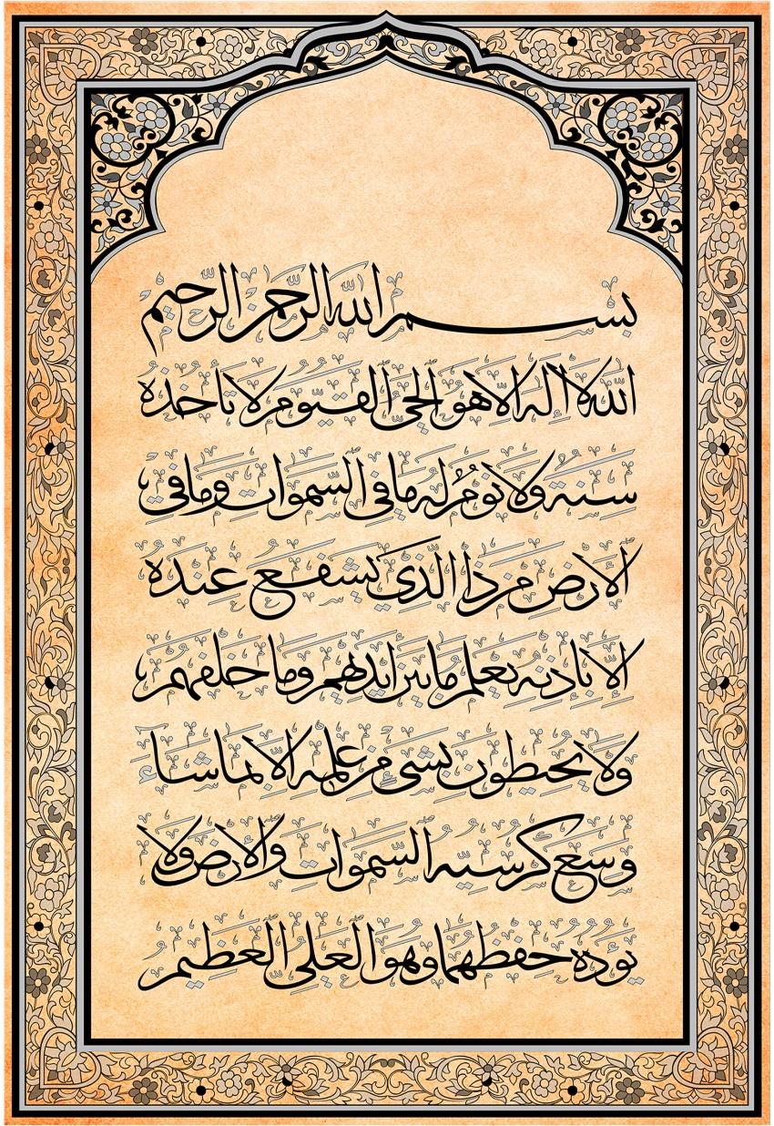
“Allah - there is no deity except Him
The Ever-Living, the Sustainer of all existence
Neither drowsiness overtakes Him nor sleep
To Him belongs whatever is in the heavens and whatever is on the earth
Who is it that can intercede with Him except by His permission?
He knows what is presently before them and what will be after them
And they encompass not a thing of His knowledge except for what He wills
His Kursi extends over the heavens and the earth
And their preservation tires Him not
And He is the Most High, the Most Great” (2:255)

Slide 7


Isn’t Allah  the Most Merciful, isn’t He Aware, doesn’t He Care?
Why is He allowing all this Injustice, Oppression and Killings?
Allah  is not bound or restricted to conform to human norms or expectations! He is Allah , He is Exalted, He is the Most-Wise, He is the All-Knowledgeable!
“He is not questioned about what He does, but they will be questioned” (21:23)
“And You will certainly be questioned about what you used to do” (16:93)
Notes:
لَا يُسْأَلُ عَمَّا يَفْعَلُ وَهُمْ يُسْأَلُونَ ‎
وَلَتُسْأَلُنَّ عَمَّا كُنتُمْ تَعْمَلُونَ

Slide 8
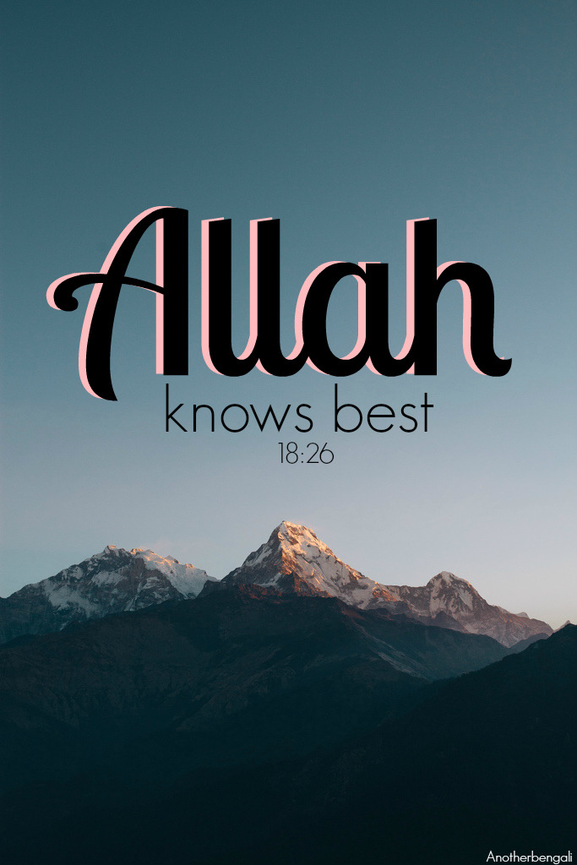
“He is Allah, other than whom there is no deity
Knower of the unseen & the witnessed
He is the Entirely Merciful, the Especially Merciful
He is Allah, other than whom there is No Deity, The Sovereign, The Pure, The Perfection, The Bestower Of Faith
The Overseer, The Exalted In Might, The Compeller, The Superior
Exalted is Allah above whatever they associate with Him
He is Allah, the Creator, the Inventor, the Fashioner; to Him belong the best names
Whatever is in the heavens & earth is exalting Him
He is the Exalted in Might, the Wise. “(59:22-24)
Notes:
هُوَ اللَّهُ الَّذِي لَا إِلَٰهَ إِلَّا هُوَ عَالِمُ الْغَيْبِ وَالشَّهَادَةِ هُوَ الرَّحْمَٰنُ الرَّحِيمُ
هُوَ اللَّهُ الَّذِي لَا إِلَٰهَ إِلَّا هُوَ الْمَلِكُ الْقُدُّوسُ السَّلَامُ الْمُؤْمِنُ الْمُهَيْمِنُ الْعَزِيزُ الْجَبَّارُ الْمُتَكَبِّرُ سُبْحَانَ اللَّهِ عَمَّا يُشْرِكُونَ
وَ اللَّهُ الْخَالِقُ الْبَارِئُ الْمُصَوِّرُ لَهُ الْأَسْمَاءُ الْحُسْنَىٰ يُسَبِّحُ لَهُ مَا فِي السَّمَاوَاتِ وَالْأَرْضِ وَهُوَ الْعَزِيزُ الْحَكِيمُ

Slide 9
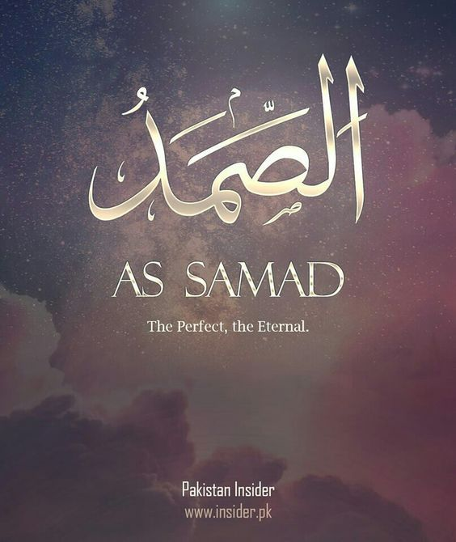
As Muslims – our Belief does not change
No matter the circumstances – through good, bad, hear, difficult, horror, sadness
We believe in Allah, worship Allah, trust Allah, surrender to Allah & Return to Allah!
Allah  does not change for us
We change for Him!
Allah’s Names and Attributes do not change
We transform to be worthy of them!
Allah’s Wisdom is Everlasting
Allah’s Actions Are Just
Allah’s Knowledge is Perfect
Allah’s Mercy is Infinite
Allah is Absolute!
Notes:
Rahmaan and Raheem isn’t based on our interpretations or the way we expect

Slide 10
REMEMBER - ALLAH  REWARD IS LIMITLESS
AL-RAHEEM will envelop the martyrs in His Mercy
AL-WADOOD will grant the martyrs eternal bliss
AL-SHAKOOR will generously reward the efforts of those who struggled & preserved
REMEMBER - ALLAH  WILL TAKE REVENGE
AL-JABBAAR will fix the hearts of the wounded
AL-QAHHAAR will unleash His wrath upon the oppressors
AL-ADL will not let the crimes of the tyrants go unpunished
AL-HAKEEM will not let the suffering of the Palestinians be in vain

Slide 11
REMEMBER - ALLAH  IS THE BEST PROTECTOR
AL-WAKEEL will never abandon his true slaves
AL-MAWLAA will never fail in protecting His servants
AL-FATTAAH will open ways of Jannah for his servants
AL-NASEER will grant victory to His unwavering servants
REMEMBER - ALLAH  IS AWARE OF EVERYTHING
AL-SHAHEED is witnessing the genocide
AL-ALEEM is not oblivious to the agonies and injuries
AL-SAMEE is hearing all the cries of the babies
AL-BASEER is seeing all the lives being destroyed
AL-RAQEEB sees through the lies of the oppressors
AL-MUHEET is keeping count of all the crimes of & their allies

Slide 12


“Among the believers are men true to what they promised Allah
Among them is he who has fulfilled his vow [to the death], and among them is he who awaits [his chance]
And they did not alter [the terms of their commitment] by any alteration –
So that Allah may reward the truthful for their truth and punish the hypocrites if He wills or accept their repentance
Indeed, Allah is ever Forgiving and Merciful. And Allah repelled those who disbelieved, in their rage, not having obtained any good
And sufficient was Allah for the believers in battle, and ever is Allah Powerful and Exalted in Might.” ‎(33:23-25)
Notes:
مِنَ الْمُؤْمِنِينَ رِجَالٌ صَدَقُوا مَا عَاهَدُوا اللَّهَ عَلَيْهِ فَمِنْهُم مَّن قَضَىٰ نَحْبَهُ وَمِنْهُم مَّن يَنتَظِرُ وَمَا بَدَّلُوا تَبْدِيلًا لِّيَجْزِيَ اللَّهُ الصَّادِقِينَ بِصِدْقِهِمْ وَيُعَذِّبَ الْمُنَافِقِينَ إِن شَاءَ أَوْ يَتُوبَ عَلَيْهِمْ إِنَّ اللَّهَ كَانَ غَفُورًا رَّحِيمًا وَرَدَّ اللَّهُ الَّذِينَ كَفَرُوا بِغَيْظِهِمْ لَمْ يَنَالُوا خَيْرًا وَكَفَى اللَّهُ الْمُؤْمِنِينَ الْقِتَالَ وَكَانَ اللَّهُ قَوِيًّا عَزِيزًا ‎

Slide 13
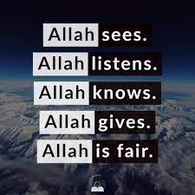
BUT ALLAH  SHOULD STILL PUNISH THEM AND DESTROY THEM NOW! RIGHT?
“If Allah were to seize people upon their deeds
He would leave no creature walking on the surface of the earth
But He gives them respite till a fixed term
And when their term comes
So indeed Allah is observing all His servants!” (35:45)
Notes:
وَلَوْ يُؤَاخِذُ اللَّهُ النَّاسَ بِمَا كَسَبُوا مَا تَرَكَ عَلَىٰ ظَهْرِهَا مِن دَابَّةٍ وَلَٰكِن يُؤَخِّرُهُمْ إِلَىٰ أَجَلٍ مُّسَمًّى ۖ فَإِذَا جَاءَ أَجَلُهُمْ فَإِنَّ اللَّهَ كَانَ بِعِبَادِهِ بَصِيرًا

Slide 14
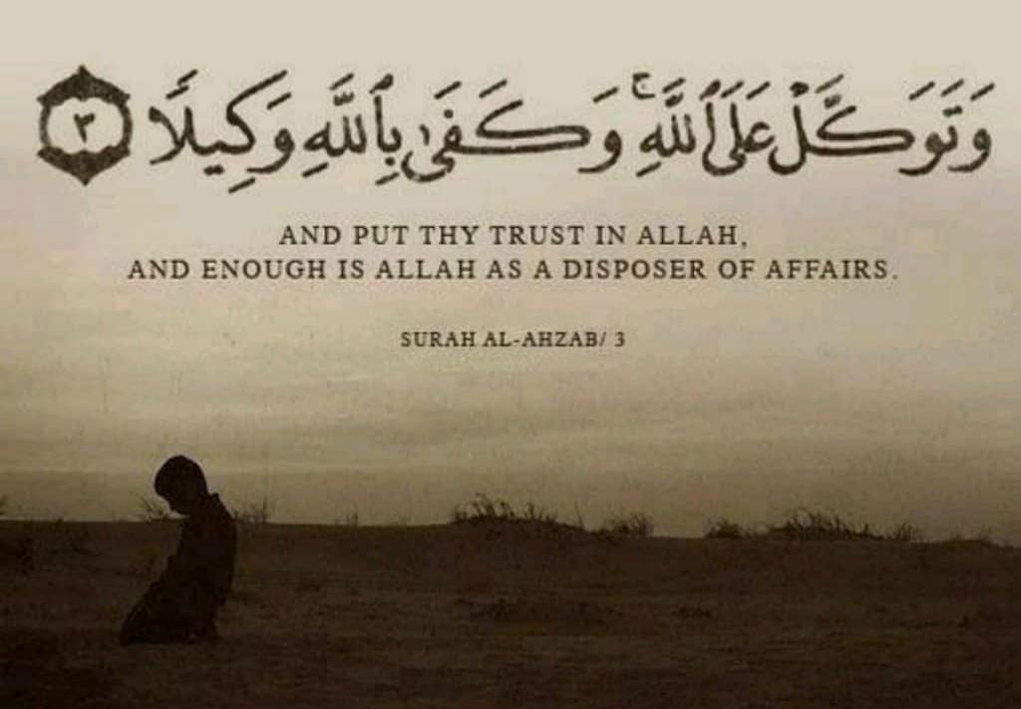
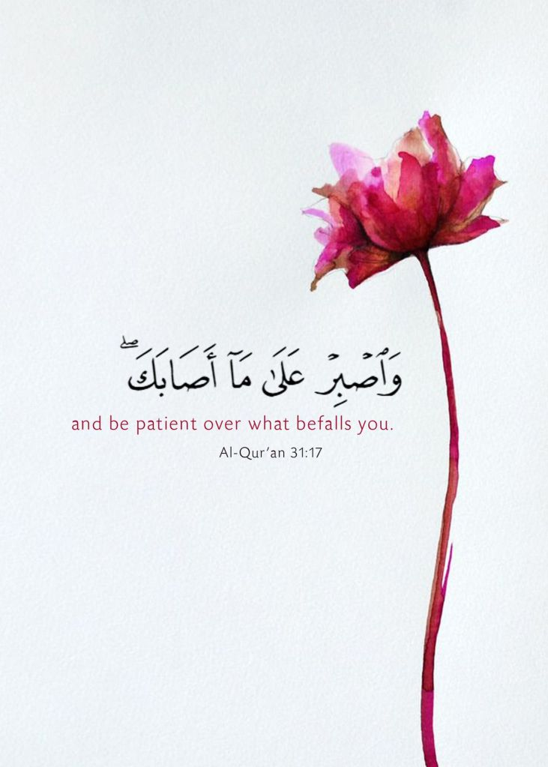
“Perhaps you hate a thing and it is good for you; and perhaps you love a thing and it is bad for you. And Allah Knows, while you know not.” (2:216)
“Perhaps you dislike a thing and Allah makes therein much good.” (4:19)
Notes:
عَسَىٰ أَن تَكْرَهُوا شَيْئًا وَهُوَ خَيْرٌ لَّكُمْ وَعَسَىٰ أَن تُحِبُّوا شَيْئًا وَهُوَ شَرٌّ لَّكُمْ وَاللَّهُ يَعْلَمُ وَأَنتُمْ لَا تَعْلَمُونَ
عَسَىٰ أَن تَكْرَهُوا شَيْئًا وَيَجْعَلَ اللَّهُ فِيهِ خَيْرًا كَثِيرًا

Slide 15
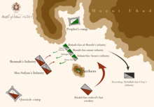
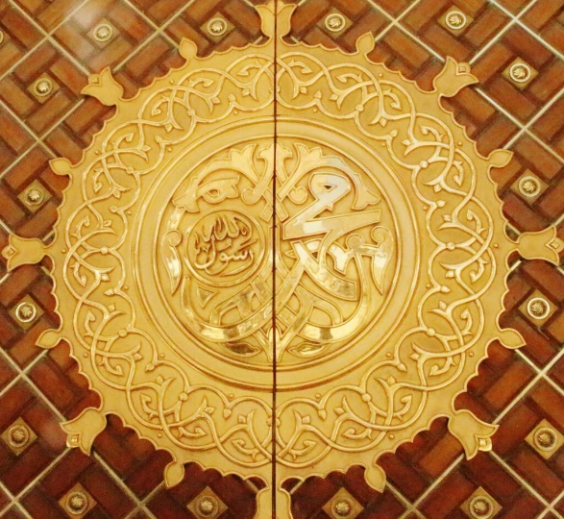
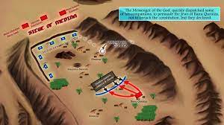
READ THE SEERAH – WE ALREADY KNOW WHAT TO DO!
Muslims lost in Uhud, Sayyidna Hamzah  was martyred, uncle of the Prophet 
We can’t always see the wisdom, through loss Allah  made them stronger!
Battle of Badr – Khayr followed by battle of Uhud/Khandaq of great Difficulty
Why didn’t Allah  grant victory to Prophet  immediately in Khandaq?
Why were they besieged until they were shaken severely?
Why were Muslim economically, financially & socially boycotted for 3 years?

Slide 16
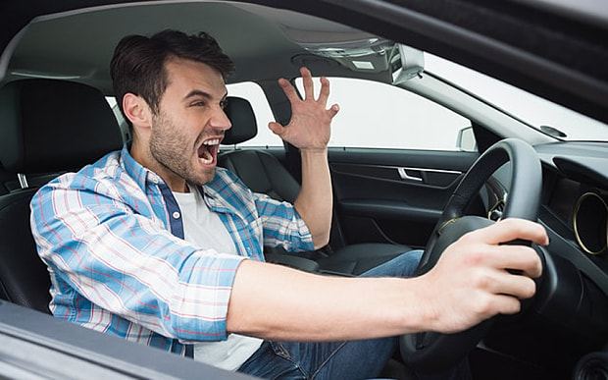
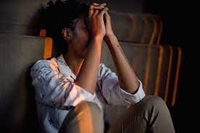
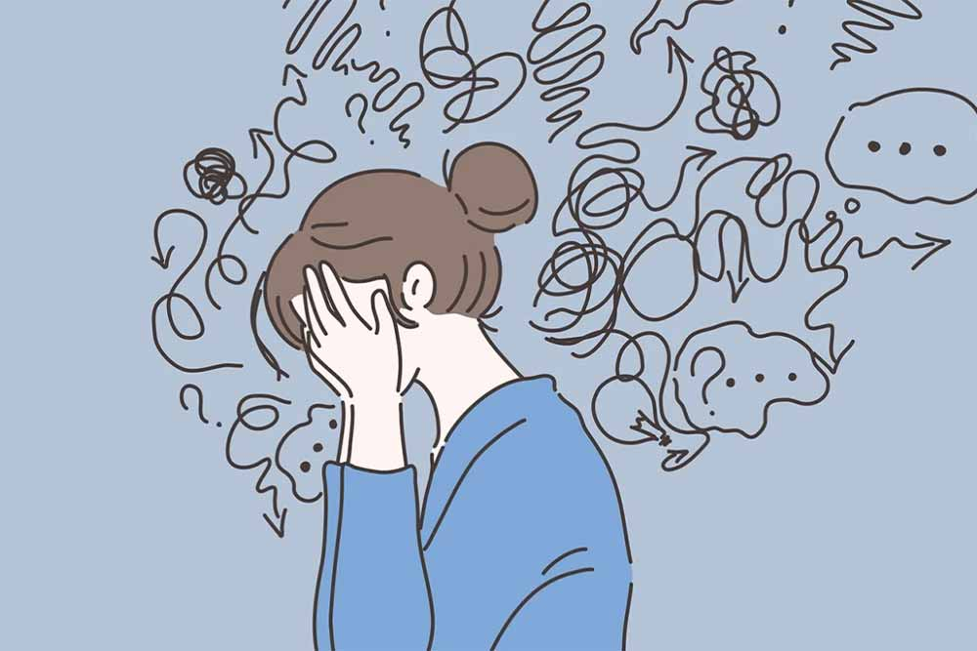
However, Insaan is WEAK, ANXIOUS, IMPATIENT, HASTY, UNGRATEFUL, FORGETFUL
- وَخُلِقَ الْإِنسَانُ ضَعِيفًا - وَكَانَ الْإِنسَانُ عَجُولًا - إِنَّ الْإِنسَانَ خُلِقَ هَلُوعًا - إِذَا مَسَّهُ الشَّرُّ جَزُوعًا ‎
THIS DOES NOT APPLY TO ALLAH ! Allah  does NOT Waver, Err Allah is Not Impatient, Anxious, Hasty, Weak, Do Any Injustice
Notes:
إِلَى اللَّهِ مَرْجِعُكُمْ وَهُوَ عَلَىٰ كُلِّ شَيْءٍ قَدِيرٌ To Allah is your return, and He is over all things powerful.“ (11:4)

Slide 17

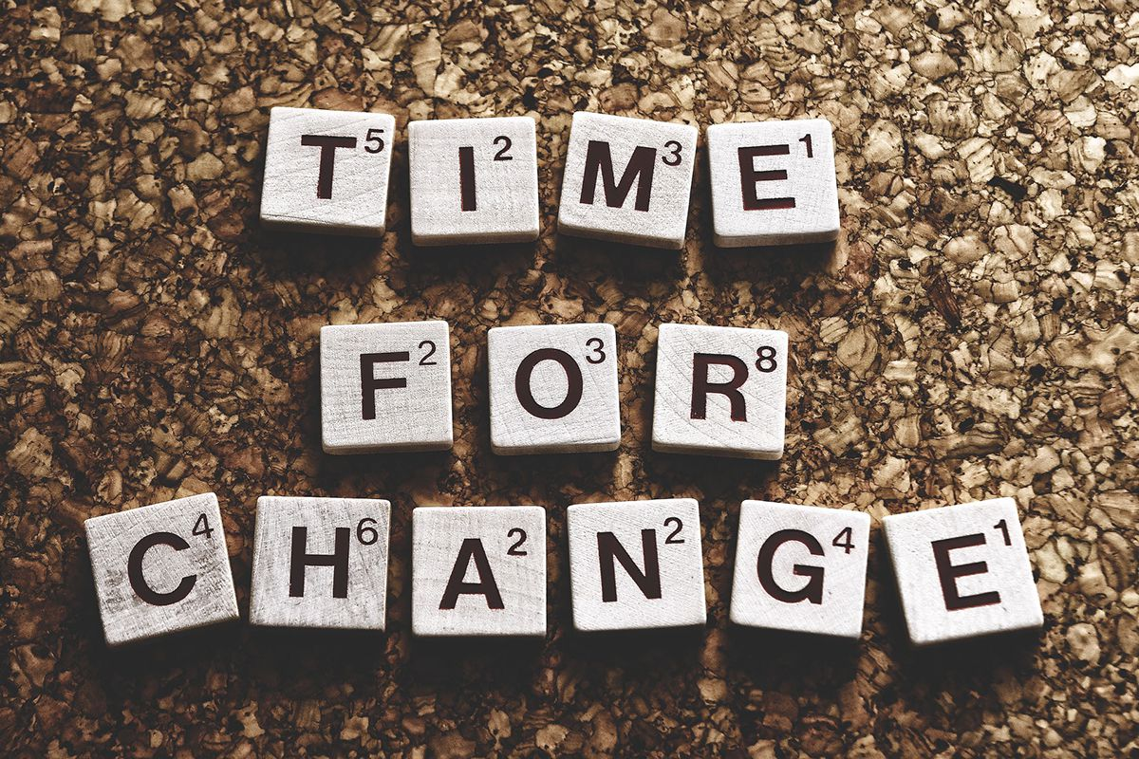
REALISE:
What is my role? What does Allah  want from me?
Why did He allow me to see this or for this to happen?
Not everything we see is evil!
We don’t understand everything in this world!
NOW ISN’T THE TIME TO ASK WHY – BUT REALISE WHAT DO I NEED TO DO
Allah  wants you to return to Him, Change, Du’a, Charity, Faith, Trust, Relationship
We have nothing else but Allah  - nothing happens in without His permission!
Notes:
إِلَى اللَّهِ مَرْجِعُكُمْ وَهُوَ عَلَىٰ كُلِّ شَيْءٍ قَدِيرٌ To Allah is your return, and He is over all things powerful.“ (11:4)

Slide 18

HOW/WHEN WILL THE VICTORY OF ALLAH  COME?
Battle of Khandaq - Best of companions – Best of Prophets – Took almost 4 weeks
Part of the test is to strive for Allah 
Victory comes through Patience & Steadfastness
Firawn massacred thousands of children for years, then brought up Musa  for 40 years – then the road to victory began.
Notes:
Victory in Dunya? Victory over Nafs? Victory Over Evil?
Victory is With & in Allah
Victory is Hereafter
Sacrifices Not in Vain

Slide 19
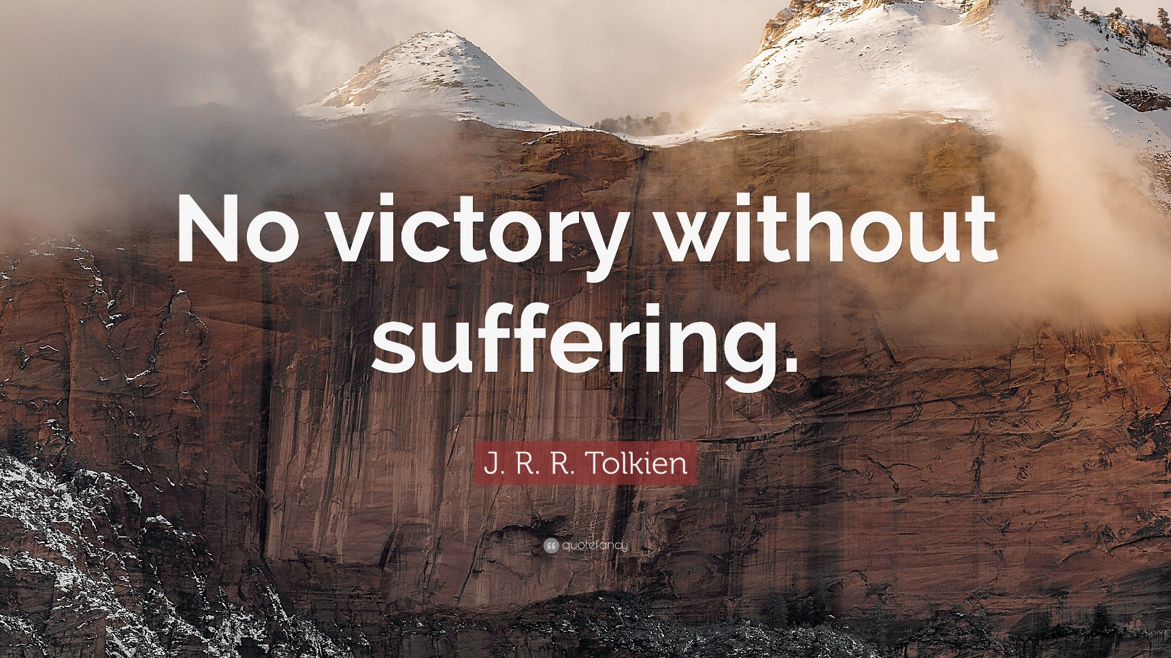
“But do you think that you could enter paradise without having suffered like those [believers] who passed away before you? Misfortune and hardship befell them, and so shaken were they that the apostle, and the believers with him, would exclaim, "When will God’s victory come?" Oh, verily, God’s victory is [always] near!” (2:214)
Notes:
أَمْ حَسِبْتُمْ أَن تَدْخُلُوا الْجَنَّةَ وَلَمَّا يَأْتِكُم مَّثَلُ الَّذِينَ خَلَوْا مِن قَبْلِكُم مَّسَّتْهُمُ الْبَأْسَاءُ وَالضَّرَّاءُ وَزُلْزِلُوا حَتَّىٰ يَقُولَ الرَّسُولُ وَالَّذِينَ آمَنُوا مَعَهُ مَتَىٰ نَصْرُ اللَّهِ أَلَا إِنَّ نَصْرَ اللَّهِ قَرِيبٌ

Slide 20


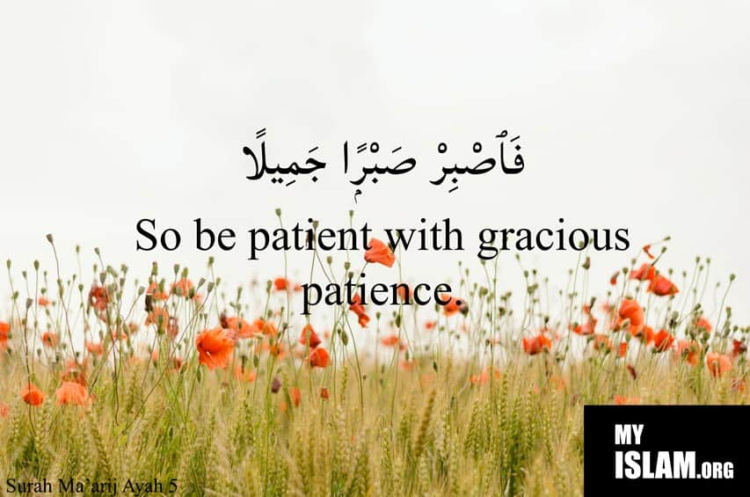
“Believers endure adversity with goodly patience
Indeed, they see it [as] distant, But We see it as near.” (70:5-7)
بُعِثْتُ أَنَا وَالسَّاعَةَ كَهَاتَيْنِ - "I have been sent and the Hour as these two fingers
QAREEB – Near - Proximity is not by my or your calculations
It’s Qareeb by Allah  - They view it as far, but Allah  views it as close
What can’t change is our belief is that VICTORY IS QAREEB

Slide 21


Not new for us as Muslims - for Allah  to impose other nations over us, so that we be patient, realise the truth, see the honest, upright, righteous, and faithful.
Muslims strived in Makkah but Allah  imposed the Mushriks over them. They were harmed, tortured, killed and boycotted us for 3/4 years. Food cut off, water, supplies, marriages, political, tribal, economic boycott - open air imprisonment.
The Jews betrayed them in Madinah & controlled the major resources. Romans, Persians, Crusaders, Mongols, Colonisation and Zionism. Limited Alternating Days!
Notes:
What is the strength of the people of Gaza?
True servants of Allah - Trust in Allah - Believe in Allah, Obey Allah, Close to Allah
Hadith – the thing I fear the most for you is the splendour and pleasure of this worldly life”
We are being tested with luxury; they are being tested with patience.
Dunya takes focus away from hereafter. They are not connected to luxury, they are connected to Allah. And Allah tests his loved ones with great tests.
Never despair from Rahma and Nasr of Allah

Slide 22
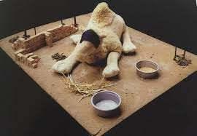

“Say, "O Allah, Owner of Sovereignty, You give sovereignty to whom You will and You take sovereignty away from whom You will. You honour whom You will and You humble whom You will. In Your hand is [all] good. Indeed, You are over all things competent.” (3:26)
Notes:
Al-Qaswa was the she-camel of Prophet Mohamed SAWW. It was born in camp sites of the tribe of Bani Qashir. He bought it from Abi Baker RA (when camel was four years old) by paying him 400 Dirhams. It was reddish with mixture of white & black.
Al-Qaswa was privileged to accompany Prophet Mohamed SAW in amazing landmarks such as journey of Hijrah from Makkah to Madinah, Battles of Badr, on the day of Hudaibiya, during the Hajj, etc.
It was the only camel which was able to bear Prophet Mohamed SAW while revelations came to Him.
After Prophet Mohamed SAW passed away, Al-Qaswa refused food & water, and died shortly afterwards at the age of 15.
Indeed, Prophet Mohamed SAW was sent as mercy to the Universe.

Slide 23

“We alternate among the people so that Allah may make evident those who believe and [may] take to Himself from among you martyrs - Allah hates the wrongdoers “
They defeated us, we defeated them, they took from us, we took from them.
“And do not weaken in pursuit of the enemy. If you should be suffering - so are they suffering as you are suffering, but you expect from Allah that which they expect not. And Allah is ever Knowing and Wise.” (4:104)
Notes:
وَتِلْكَ الْأَيَّامُ نُدَاوِلُهَا بَيْنَ النَّاسِ وَلِيَعْلَمَ اللَّهُ الَّذِينَ آمَنُوا وَيَتَّخِذَ مِنكُمْ شُهَدَاءَ وَاللَّهُ لَا يُحِبُّ الظَّالِمِينَ (3:140)
وَلَا تَهِنُوا فِي ابْتِغَاءِ الْقَوْمِ إِن تَكُونُوا تَأْلَمُونَ فَإِنَّهُمْ يَأْلَمُونَ كَمَا تَأْلَمُونَ وَتَرْجُونَ مِنَ اللَّهِ مَا لَا يَرْجُونَ وَكَانَ اللَّهُ عَلِيمًا حَكِيمًا
We must show to Allah  that we are His true servants.
We are convinced and firm upon His promise.
We are upon His obedience and command.
اللّهُـمَّ إِنِّي عَبْـدُكَ ابْنُ عَبْـدِكَ ابْنُ أَمَتِـكَ نَاصِيَتِي بِيَـدِكَ مَاضٍ فِيَّ حُكْمُكَ عَدْلٌ فِيَّ قَضَاؤكَ أَسْأَلُـكَ بِكُلِّ اسْمٍ هُوَ لَكَ سَمَّـيْتَ بِهِ نَفْسَكَ أِوْ أَنْزَلْتَـهُ فِي كِتَابِكَ أَوْ عَلَّمْـتَهُ أَحَداً مِنْ خَلْقِـكَ أَوِ اسْتَـأْثَرْتَ بِهِ فِي عِلْمِ الغَيْـبِ عِنْـدَكَ أن تنصر المسلمين في فلسطين ، اللهم امين

Slide 24
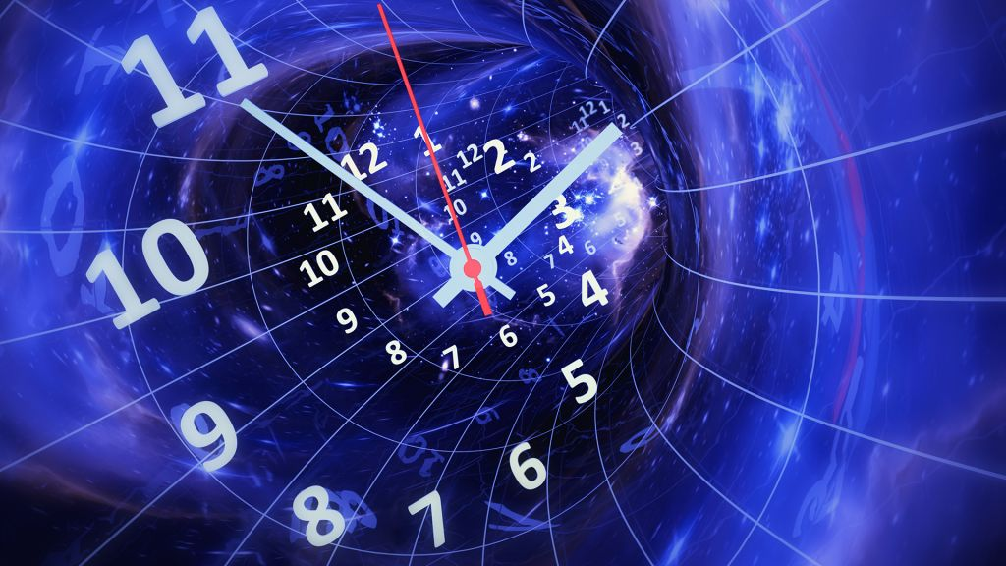

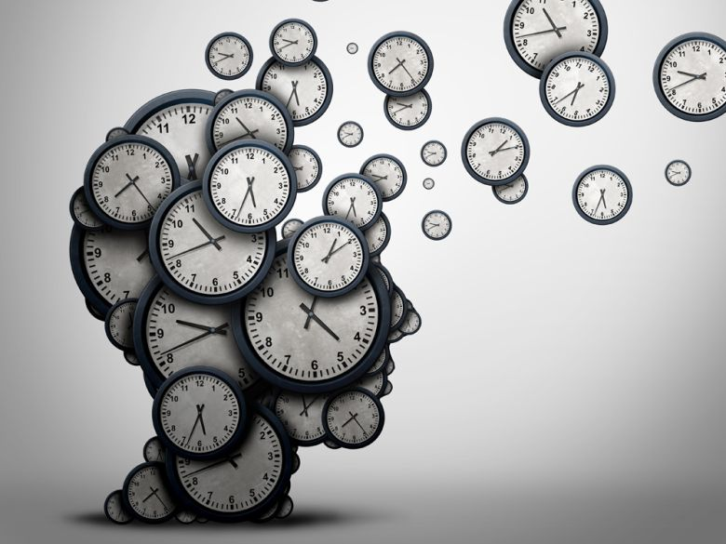
“They strive in the cause of Allah and do not fear the blame of a critic.” (5:54)
This Dunya is barely a few minutes in comparison to the eternity of the hereafter
“The angels and the Spirit will ascend to Him during a Day the extent of which is fifty thousand years. So be patient with gracious patience. Indeed, they see it [as] distant, But We see it [as] near.” (7:4-4)
50,000 years – 1 minute = 34.7 years – how long are we on this earth? 2/3 minutes?
A day on Venus is 234 earth days – 5,832 hours. FOR ALLAH  BE PATIENT - 2/3 MINUTES!
Notes:
يُجَاهِدُونَ فِي سَبِيلِ اللَّهِ وَلَا يَخَافُونَ لَوْمَةَ لَائِمٍ
تَعْرُجُ الْمَلَائِكَةُ وَالرُّوحُ إِلَيْهِ فِي يَوْمٍ كَانَ مِقْدَارُهُ خَمْسِينَ أَلْفَ سَنَةٍ فَاصْبِرْ صَبْرًا جَمِيلًا إِنَّهُمْ يَرَوْنَهُ بَعِيدًا وَنَرَاهُ قَرِيبًا
قَالَ كَمْ لَبِثْتُمْ فِي الْأَرْضِ عَدَدَ سِنِينَ قَالُوا لَبِثْنَا يَوْمًا أَوْ بَعْضَ يَوْمٍ فَاسْأَلِ الْعَادِّينَ قَالَ إِن لَّبِثْتُمْ إِلَّا قَلِيلًا ۖ لَّوْ أَنَّكُمْ كُنتُمْ تَعْلَمُونَ
Imagine I asked a child to be patient for 5 minutes and not eat this candy – or an adult to wait for me in line for 1 hour in the cold, or for you to go to a boring conference for 3 hours or for you to remain quiet and let your cousins be horrible for the entire weekend or ignore everyone in Pakistan when they're trying to harm you/family. Mere moments in comparison to the hereafter.

Slide 25
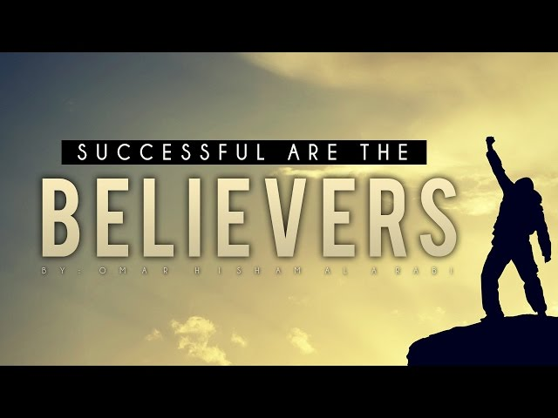
“And do not despair of relief from Allah. Indeed, no one despairs of relief from Allah except the disbelieving people." (12:87)
“So do not weaken or grieve, you will be superior if you are [true] believers.”
Earth is a place of بلاء – – hardship, plague, curse, ordeal, trouble, worry – be patient
“So be patient; indeed, the [best] outcome is for the righteous.” (11:49)
“Therefore patiently endure, indeed the promise of Allah is true; and may not those who do not have faith make you impatient.” (30:60)
“Indeed the abode of the Hereafter is indeed the true life; if only they knew.”
Notes:
وَلَا تَيْأَسُوا مِن رَّوْحِ اللَّهِ إِنَّهُ لَا يَيْأَسُ مِن رَّوْحِ اللَّهِ إِلَّا الْقَوْمُ الْكَافِرُونَ
وَلَا تَهِنُوا وَلَا تَحْزَنُوا وَأَنتُمُ الْأَعْلَوْنَ إِن كُنتُم مُّؤْمِنِينَ
فَاصْبِرْ إِنَّ الْعَاقِبَةَ لِلْمُتَّقِينَ
فَاصْبِرْ إِنَّ وَعْدَ اللَّهِ حَقٌّ وَلَا يَسْتَخِفَّنَّكَ الَّذِينَ لَا يُوقِنُونَ
وَإِنَّ الدَّارَ الْآخِرَةَ لَهِيَ الْحَيَوَانُ لَوْ كَانُوا يَعْلَمُونَ

Slide 26

We must show Allah  our patience, truth, conviction, hope, faith, actions & transformation
We must show Allah  our unity
We must remind ourselves that everything was, is and shall remain in His Hands & Control
We are the best of nations sent to mankind – PROVE IT!
We obey Allah  and his Messenger  & we do not quarrel with one another
The Palestinians are the Awliya of Allah!
THEY HAVE NO FEAR OR WORRY
Notes:
"مَنْ عَادَى لِي وَلِيًّا فَقْد آذَنْتهُ بِالْحَرْبِ، وَمَا تَقَرَّبَ إلَيَّ عَبْدِي بِشَيْءٍ أَحَبَّ إلَيَّ مِمَّا افْتَرَضْتُهُ عَلَيْهِ، وَلَا يَزَالُ عَبْدِي يَتَقَرَّبُ إلَيَّ بِالنَّوَافِلِ حَتَّى أُحِبَّهُ، فَإِذَا أَحْبَبْتُهُ كُنْت سَمْعَهُ الَّذِي يَسْمَعُ بِهِ، وَبَصَرَهُ الَّذِي يُبْصِرُ بِهِ، وَيَدَهُ الَّتِي يَبْطِشُ بِهَا، وَرِجْلَهُ الَّتِي يَمْشِي بِهَا، وَلَئِنْ سَأَلَنِي لَأُعْطِيَنَّهُ، وَلَئِنْ اسْتَعَاذَنِي لَأُعِيذَنَّهُ".
Whosoever shows enmity to a wali of Mine, then I have declared war against him.
My servant does not draw near to Me with anything more loved to Me than the religious duties I have obligated upon him.
My servant continues to draw near to me with nafil deeds until I Love him.
When I Love him, I am his hearing with which he hears, and his sight with which he sees, and his hand with which he strikes, and his foot with which he walks. Were he to ask [something] of Me, I would surely give it to him; and were he to seek refuge with Me, I would surely grant him refuge.’

Slide 27


Israel may occupy, blockade, build, enforce apartheid all against international law
Israel may abuse and take away all basic human rights
The rest of the world may support it & turn a blind eye
Allah’s Law, Dominion and Justice will be served & rights returned
Always remember Allah  is with you
Always know that Allah  will never disown you
Always remember that Allah  will never forget
Allah remember that Allah  will do justice

Slide 28
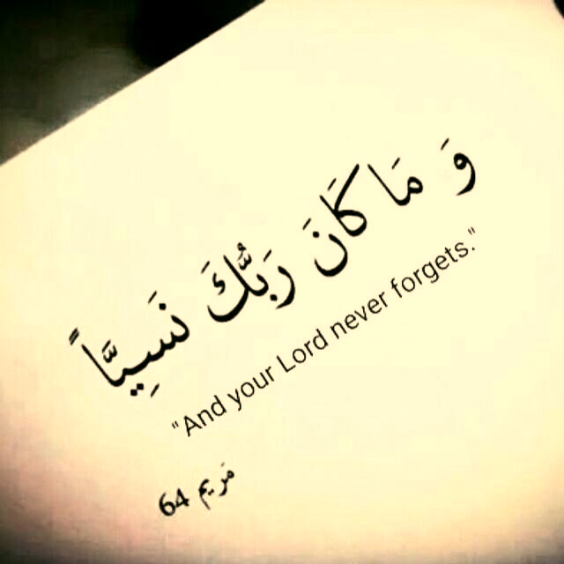

Slide 29
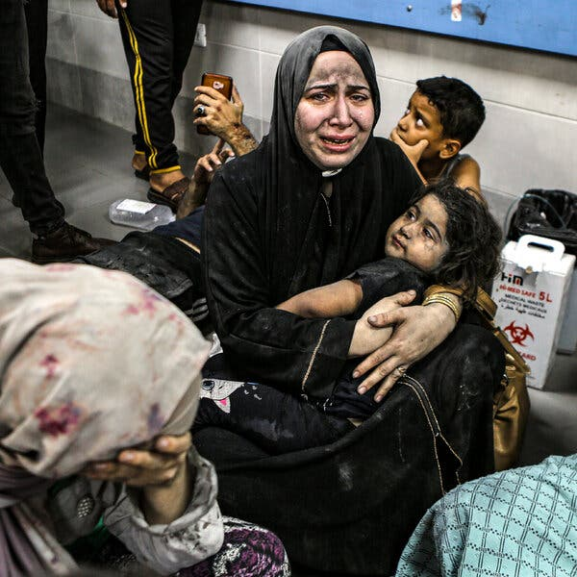

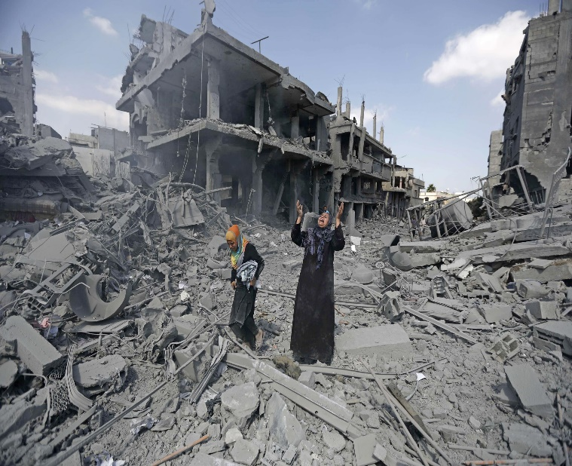

Don’t forget the parents who carried the limbs of their child in a bag
The Uncle looking at the rubble saying
“I spent 40 years building this”
The mother who refused to wash her hands covered in her baby’s blood saying “I have nothing else left of her”

Slide 30
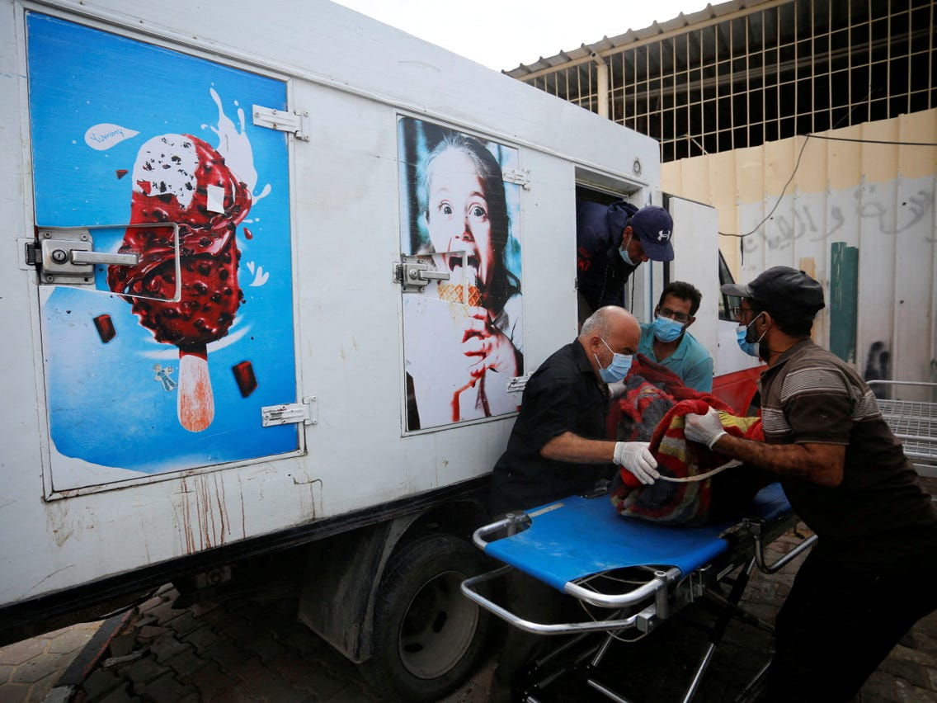
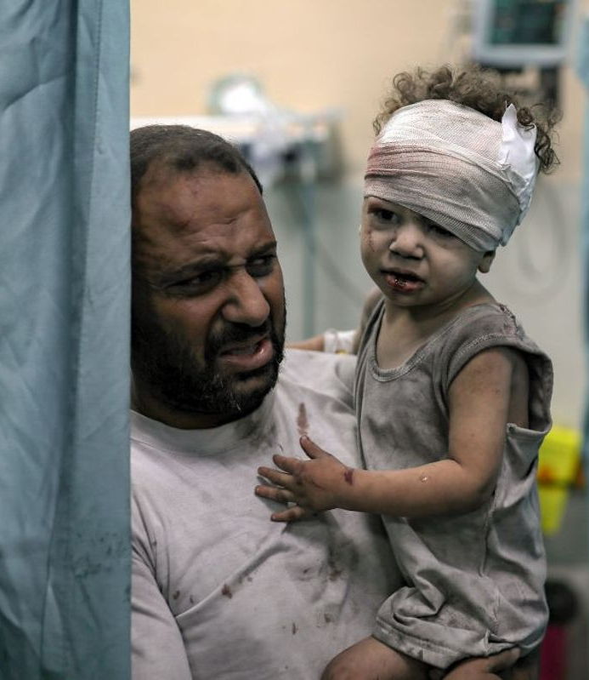
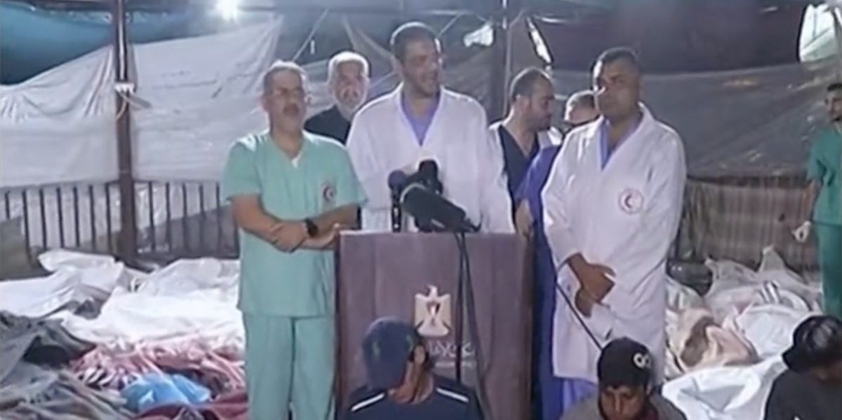
Never forget the ice cream van full of bodies of children
The mother who cried “They died hungry”
The little 7 year old boy crying “ I did nothing wrong”
The doctors singing “We will stay no matter what” even after their hospital was bombed

Slide 31
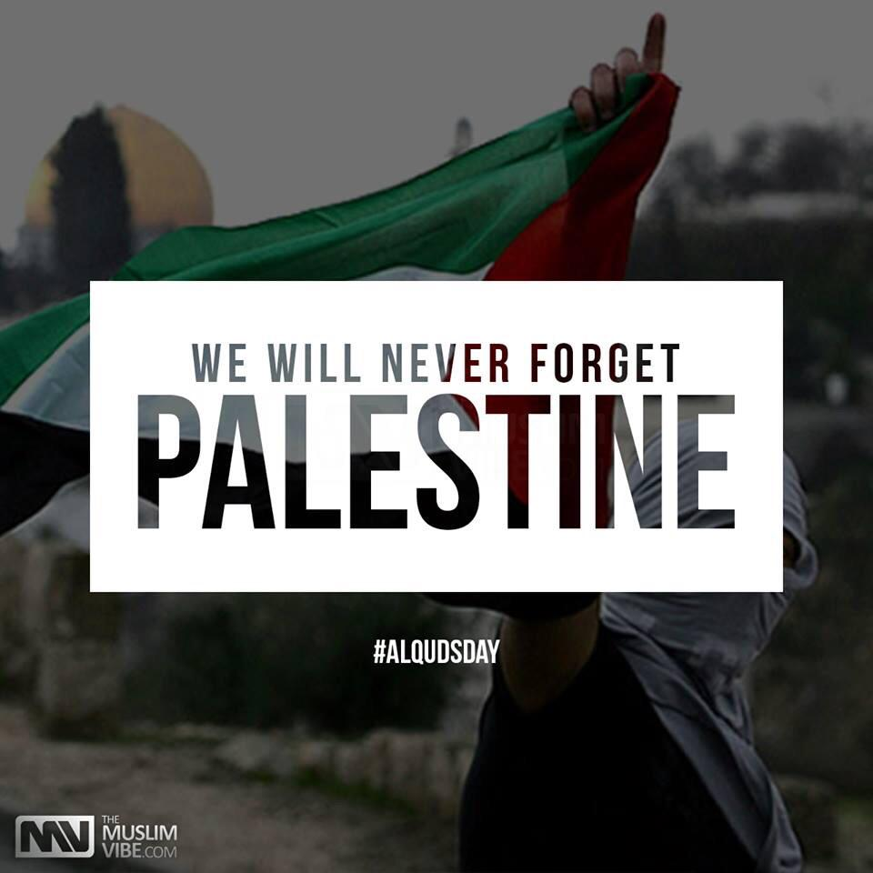
Never forget 5 year old sister holding her 1 year baby brother in her hands after her parents were bombed
Never forget the journalist who buried their family but carried on reporting
Never forget how the USA vetoed the pause of bombardment & sent billions of dollars in aid to support the genocide

Slide 32
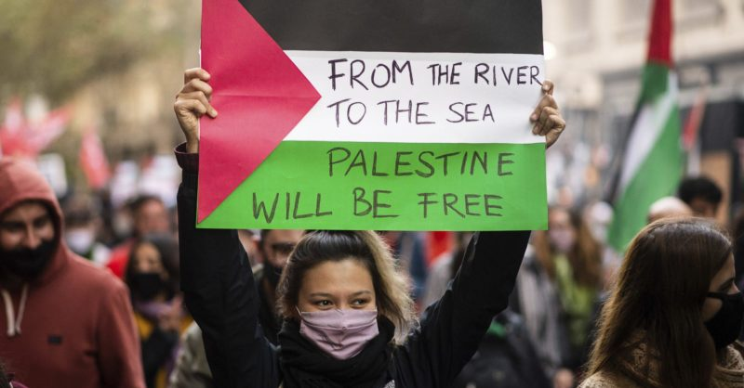
Never forget how the UK parliament voted for a ceasefire
Never forget Britian Germany France Canada walked all over human rights
Never forget how UAE celebrated Halloween and Saudia a music festival whilst innocent people were being slaughtered indiscriminately
Never forget how the Muslim & Western World failed Humanity
Notes:
وَمَا كَانَ رَبُّكَ نَسِيًّا

Slide 33

REFLECT ON WHY/HOW & START THE CHANGE IN YOURSELF
Develop your relationship with Allah 
Prepare for your return to Allah 
Do something for yourself or for OTHERS – don’t just sit there
The Prophet  taught us, if you can’t pay someone's debt off, advocate on his behalf, so debtor will forgive it

Slide 34
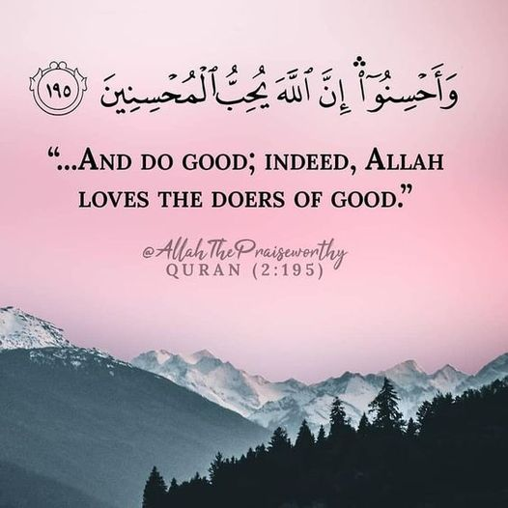
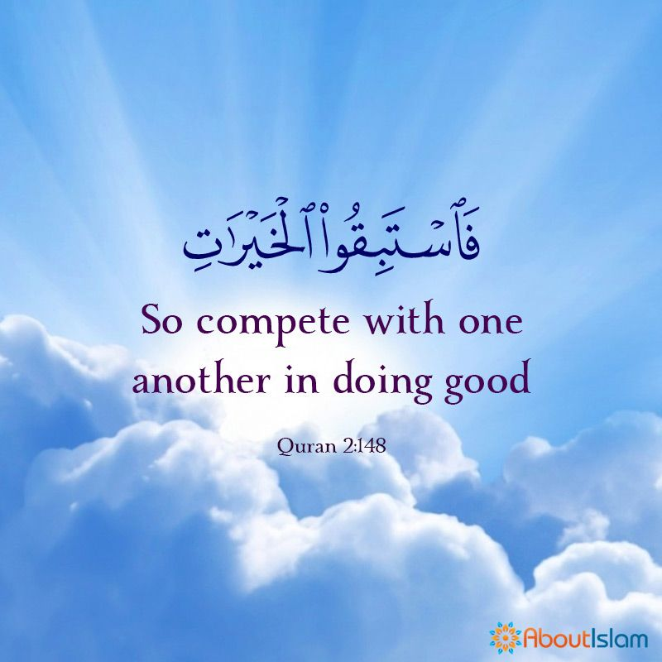
REFLECT ON WHY/HOW & START THE CHANGE IN YOURSELF
If you can’t cure someone who is sick, then care for them, give them compassion, support
If you can’t free the captive, feed the captive poor, orphan
If you can’t change their circumstances, then walk with them
DON’T BELITTLE THE GOOD YOU ARE CAPABLE OF DOING – CARRY ON

Slide 35
Allah  has brought out a very strong solidarity in this Ummah that has been missing for a long time
There will be abundant Khayr from all this In-Shaa’Allah
Ibn Taymiyyah said, “If my enemies kill me, it’s Shahadah for Allah, if they imprison me, its Khalwa with Allah, if they exile me, it’s Tadabbur with Allah”
The people of Gaza are saying this now too.
THEIR STRENGTH, RESILIENCE, HOPE & REWARD IS WITH ALLAH!
This is what Allah  wants to see in us too!

Slide 36
فَتَرَبَّصُوا حَتَّىٰ يَأْتِيَ اللَّهُ بِأَمْرِهِ
وَاللَّهُ لَا يَهْدِي الْقَوْمَ الْفَاسِقِينَ
“Wait until Allah executes His command
Allah never guides the defiantly disobedient people.” (9:24)
وَالْعَاقِبَةُ لِلْمُتَّقِينَ
“The best outcome is for the righteous.” (7:128)

Slide 37
From The River To The Sea
Palestine Will Be Free
In-shaa’allah

