Slide 1


Guilt as a part of faith
Jumu'ah Salah English Speech (Hafiz Ather Hussain) | 1:15pm-1:55pm | Ashton Central Mosque OL69JA

Slide 2

Friday – the day of salawāt

Slide 3
Shaytan’s mission
To take as many people as possible to Hell.
To do this, he sits on the Sirāt Mustaqim.
He puts doubts and whispers in our hearts whenever we do good acts that please Allah. We call this waswasa.
However, is waswasa necessarily a bad thing? What role does guilt play in our imān?

Slide 4
Point 1; Shaytan only troubles the guided
The infidels & hypocrites are already astray; no need for Shaytan to spend time on them
‘A thief never burgles an empty home’
This is why:
  We get waswasa when we give sadaqa, but never such doubts when spending materially.
  We get concentration issues in salah; but never such issues when watching mindless TV.

Slide 5
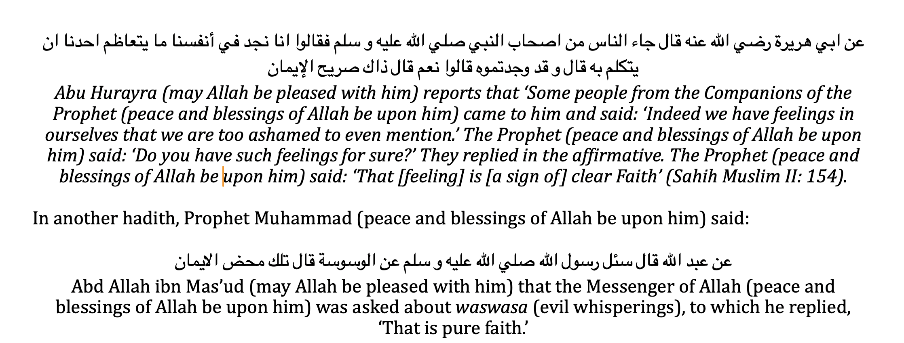
Point 2; If Shaytan is troubling us, then it means he sees faith in us
Prophet Muhammad too affirmed this:

Slide 6
Good act
Good vibes. Allah has put peace & joy in all good acts
Hence why good acts are always the best antidote to mental illness concerns

Slide 7
Bad acts
Bad vibes. Guilt and remorse. Allah has always regret in bad acts
Correct reaction
Worse reaction
Tawba and Ta’awwuz
No guilt.
‘Fair game’
Normalisation of sin

Slide 8
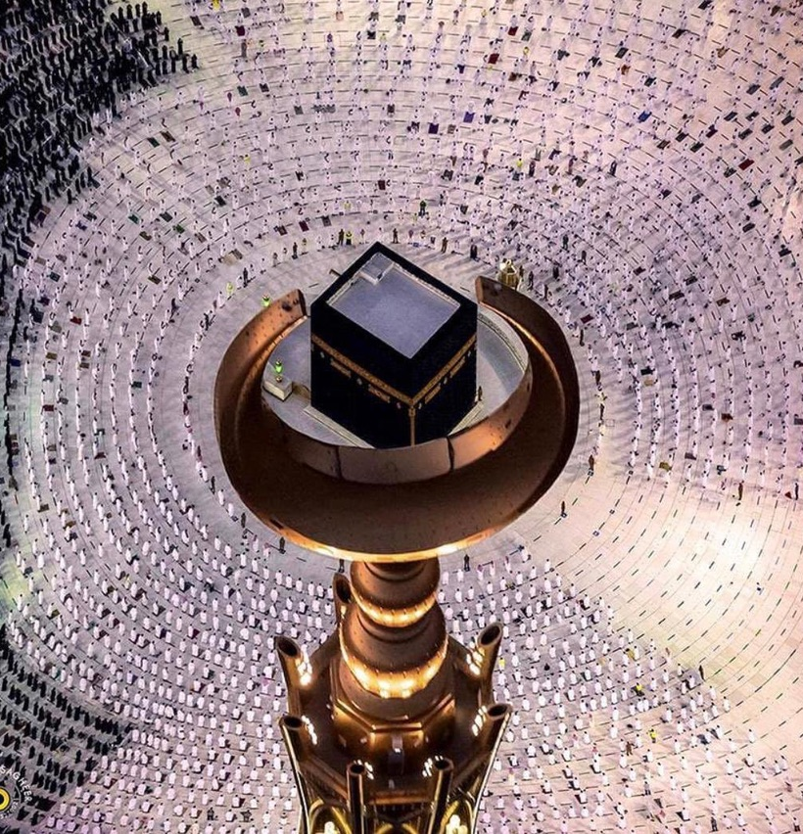
Conclusion
If you sometimes get waswasa, recite ta’awwuz immediately
Also know that this waswasa is not necessarily a bad thing; it means Shaytan is working on you. And he would only do that if you had faith.
You cannot fight Shaytan alone. Hence why we have ta’awwuz
Sinning is not the sin in Islam. We all make sins. The sin is to sin and think nothing of it.

Slide 9
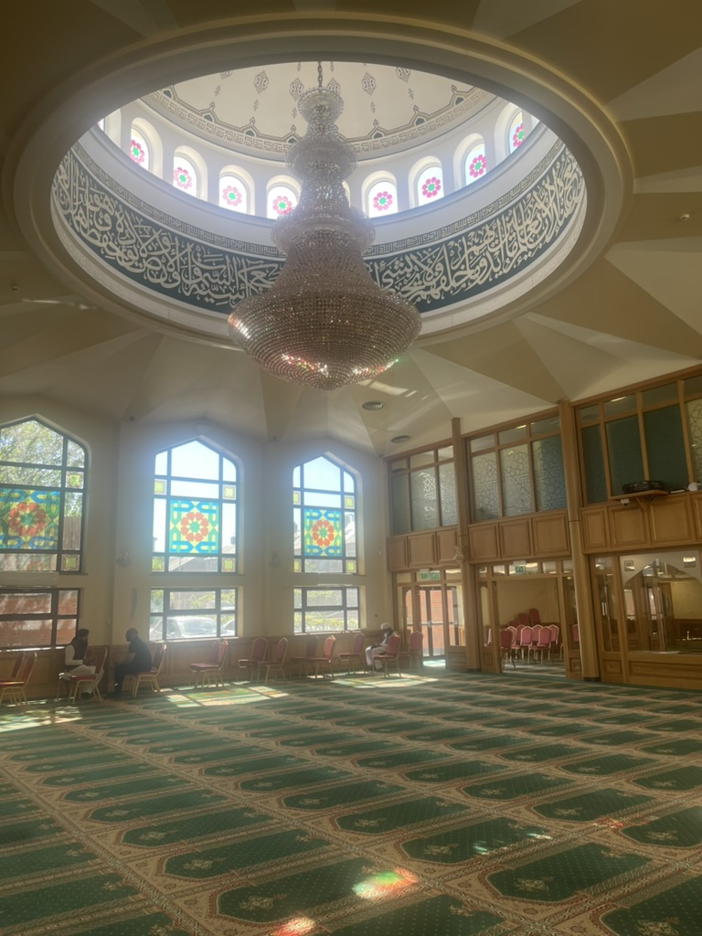
Announcements
Councilor Surgery – Fri 25th July – after Jumu’a inshallah
Salah times stay the same this week; please bring your children for prayers in the holidays.
Please donate sincerely and generously to Allah’s cause (£1976 last week).
Dua-e-Sihhat for Mrs Mahmood Ayhat
Dua-e-Maghfirat for wife of Raja Ghazi Muhammad Razzaq (ra)

Slide 10

Announcements
“The Ayah Kitchen” (Ashton Community Fridge)
10:00am- 11:30 am
Hot meal at discounted price
Volunteers welcome
This Sunday Inshallah

Slide 11

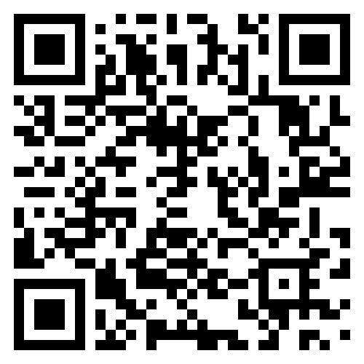
Announcements
Aqidah course for all
Classroom based teaching
Opportunities for questions
Sisters welcome
Please register (FREE)
Class II this Monday 21st July inshallah, after Asr.

