Slide 2
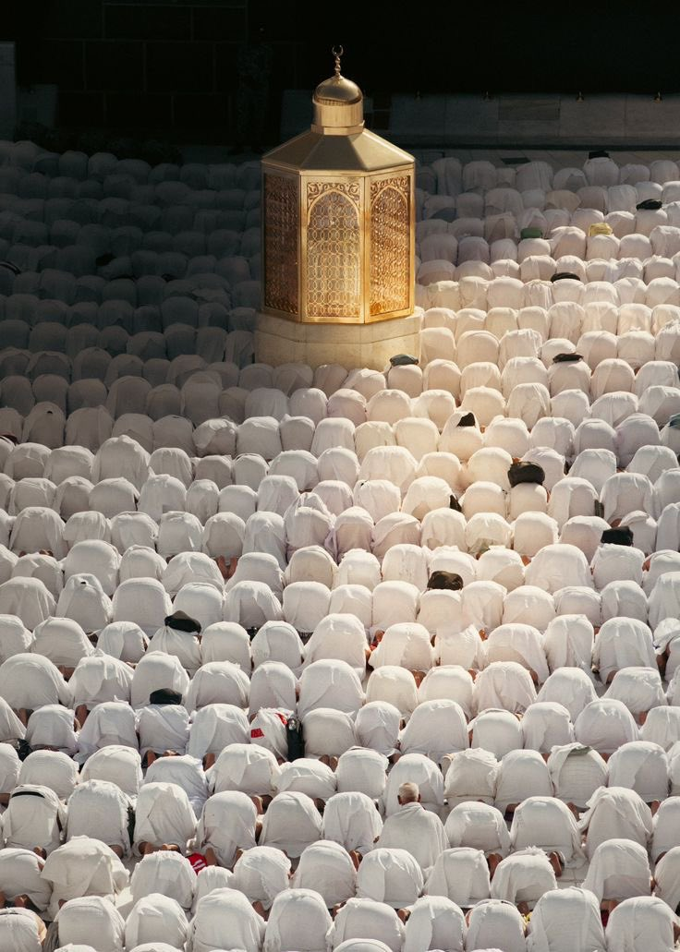
The concept of sacrifice (Qurbani) in Islam
Jumu'ah Salah English Speech
115pm-155pm
Ashton Central Mosque OL69JA

Slide 3
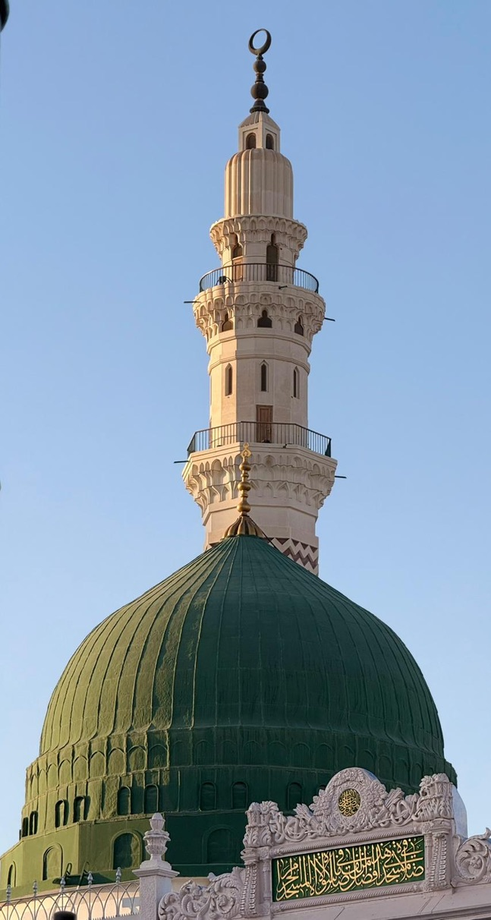
Friday – the day of salawāt

Slide 4
The end of 1446 AH…
Dhu’l Hajj marks the end of the Islamic year, and Muharram marks the start of the new year.
During this period, two figures are often mentioned…
Sayyiduna Ibrahim (as)
Imam al-Husayn (ra)
With both of them, the concept of sacrifice (qurbani) features strongly…

Slide 5
What is a sacrifice?
“When you forsake something dear and valuable to you, knowing that you will soon get some even better.”
So parting company with something beloved to you is always involved in a sacrifice. Additionally, we learn that the person who makes a sacrifice has to make a “leap of faith”, a belief that he will get something better eventually.

Slide 6
The sacrifices of the blessed ones
Sayyiduna Ibrahim (as) was willing to sacrifice his son, knowing he would get something better; the pleasure of Allah
Sayyiduna Muhammad (as) left his beloved home city of Makka, knowing Allah had something better waiting for him; the utopia of al-Madina.
Imam al-Husayn (ra) sacrificed his life, knowing that this would lead to something better; the preservation of the Muslim Ummah.

Slide 7
Sacrifices today…
There are no shortages of people making ‘sacrifices’ today. But are they real ones or beneficial ones? Does the subject end up with something better?
People sacrifice their time, money and health for:
Social Media Use
Employment
Video games and hobbies
Political causes
Digital friends
Patriotism

Slide 8
Islam and sacrifices
When you make ANY sacrifice for Allah, you ALWAYS end up with better. You NEVER make a loss.
One good act = ten units of reward
Reading books
Seeking ilm
Mosque attendance
Islamic Mahafil

Slide 9
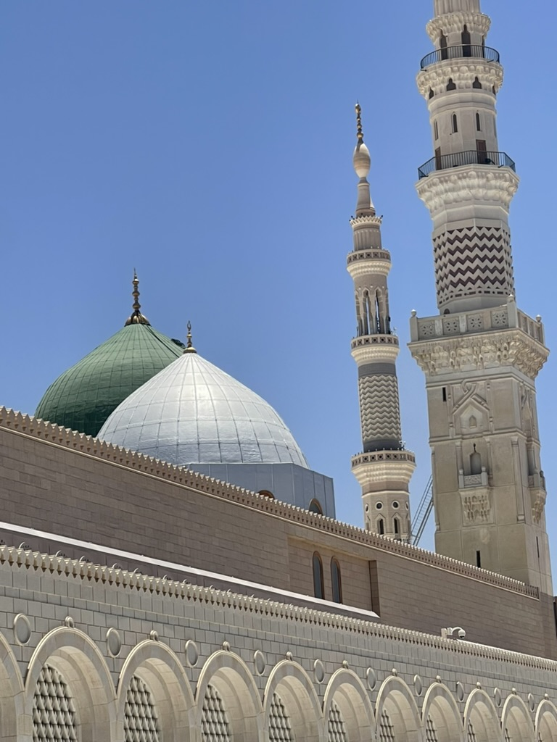
Conclusion
A sacrifice: “When you forsake something dear and valuable to you, knowing that you will soon get some even better.”
Time, money and health – be very careful where and how you sacrifice these three.
“The best return on investment is always Islam.” You never make a loss with giving time and energy to your religion.
What have we sacrificed for the sake of Allah and His Messenger (peace be upon him)?

Slide 10
Announcements
£300 raised by the madrassa children via the cake sale (12th June)!
Thursday 26th June – Area between the mosque and St James Church will be cleaned by members of the Council and public. Please participate.
Muharram programme to be announced soon Inshallah
Please continue to take benefit of the services provided by the masjid.
Please donate sincerely and generously to Allah’s cause (£2645 last week).

