Slide 1
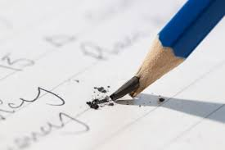

Knowledge in crisis
Jumu'ah Salah English Speech
Hafiz Ather Hussain al-Azhari
1:15pm-1:55pm
Ashton Central Mosque OL69JA

Slide 2
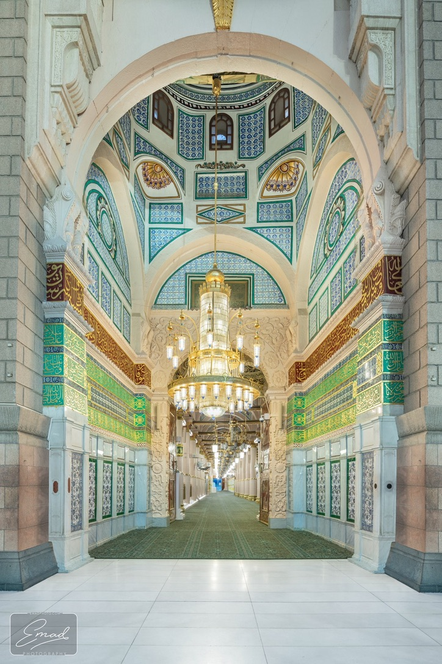
Friday – the day of salawāt

Slide 3
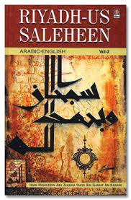


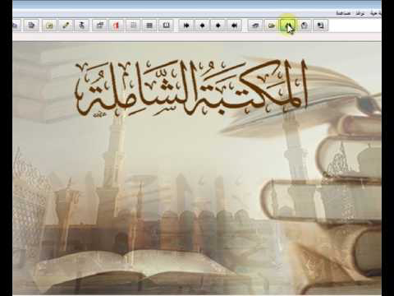
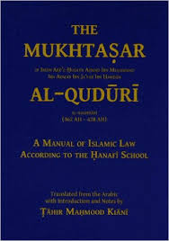
‘Ilm as our saving grace
We have never been exposed to more knowledge than ever before.
Surely, therefore, we must be guided more than ever before...

Slide 4
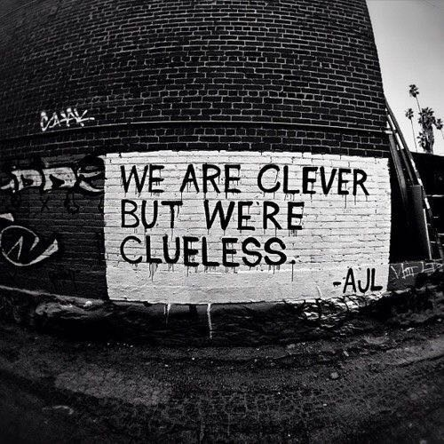
Is ‘Ilm affecting us?
Muslims are still underachieving in education.
Prisons filled with Muslims
Mosque attendance is falling
Enrollment in Dars Nizami is less than before
More social problems than ever before

Slide 5
Why isn’t ilm having any effect on us?
We have no real respect for knowledge
We do not act upon what we know
We do not learn from a teacher
We do not journey to knowledge, we want knowledge to come to us
The real carriers of knowledge, the Ulama, are disappearing

Slide 6
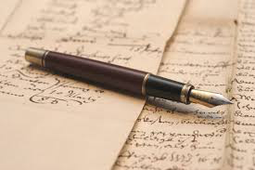
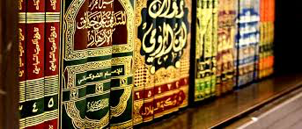
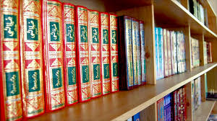
Lessening respect for knowledge
Early Muslims respected everything and everyone related to knowledge.

Slide 7
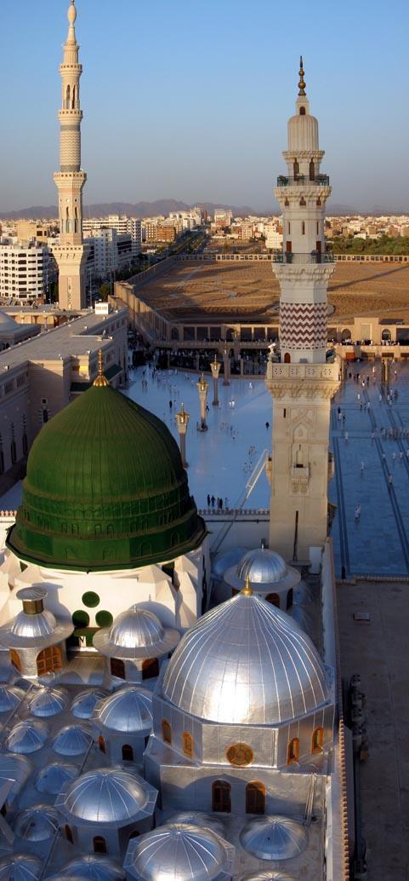
We do not act upon what we know
It is pointless to know about the Sirah of the Prophet ﷺ if one does not apply to it to one’s life.
Prophet Muhammad ﷺ sought refuge from certain things – like knowledge that does not give benefit, because it is not acted upon.

Slide 8
The Ulama are disappearing…
Prophet Muhammad ﷺ warned us that closer to the end of time, ilm will all but disappear. This will disappear not because libraries will burn to the ground, but because the Ulama will be harder to find.

Slide 9
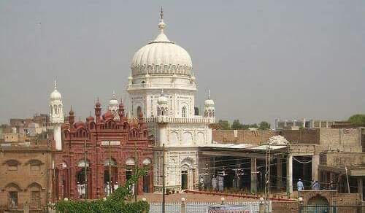
We do not learn from a teacher
When you have a teacher, you learn the inner and outer knowledge. When you are self-taught you learn the outer only.
Can you self-teach medicine? Would you trust such a doctor? Yet somehow, we think it is acceptable with Islam.

Slide 10
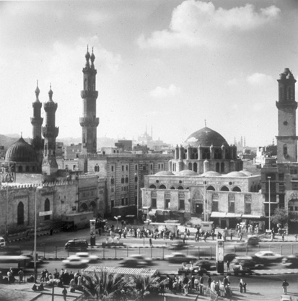
We want knowledge to come to us
‘The thirsty goes to the well, the well does not come to the thirsty.’
Prophet Muhammad ﷺ said, ‘Whosoever leaves for the sake of knowledge….

Slide 11
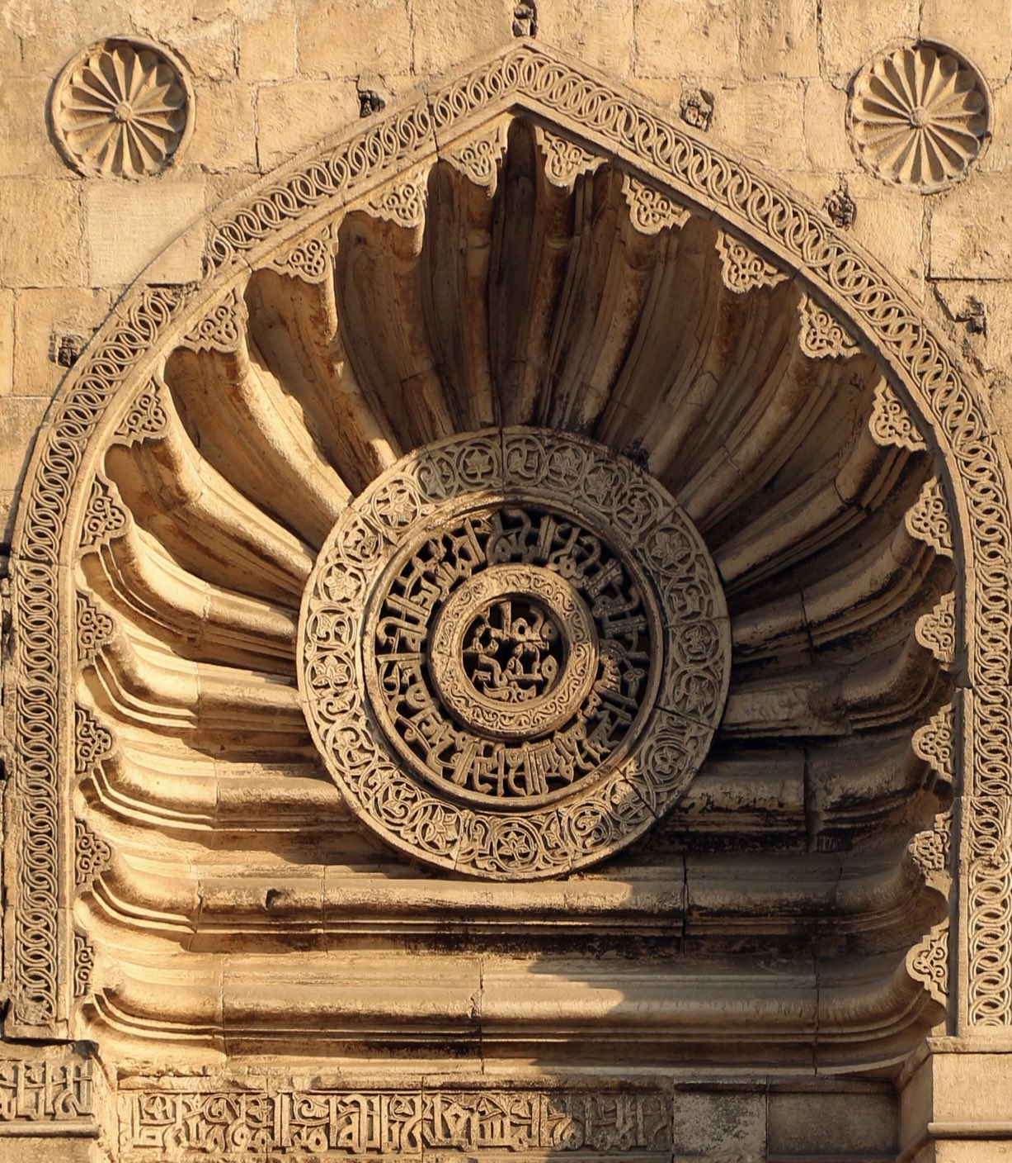
Conclusion
What is ‘ilm? Anything that brings you closer to Allah.
There can be such a thing as too much information.
How smart is the smart phone?

Slide 12
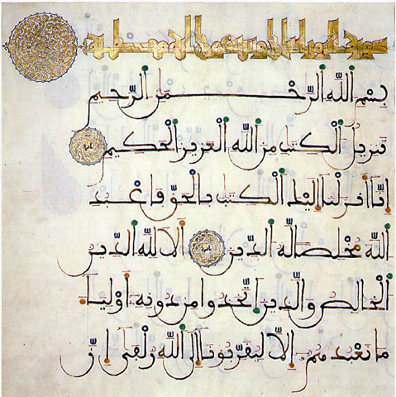
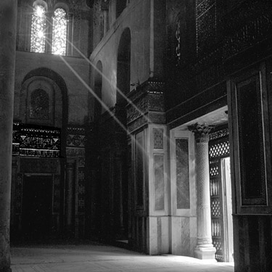
Action plan
Respect learning
Act upon what you know
Learn from a teacher, not your phone
Go to knowledge
Read books
Return to the mosque; keep your child here as long as possible
Stay thirsty for ilm!

Slide 13
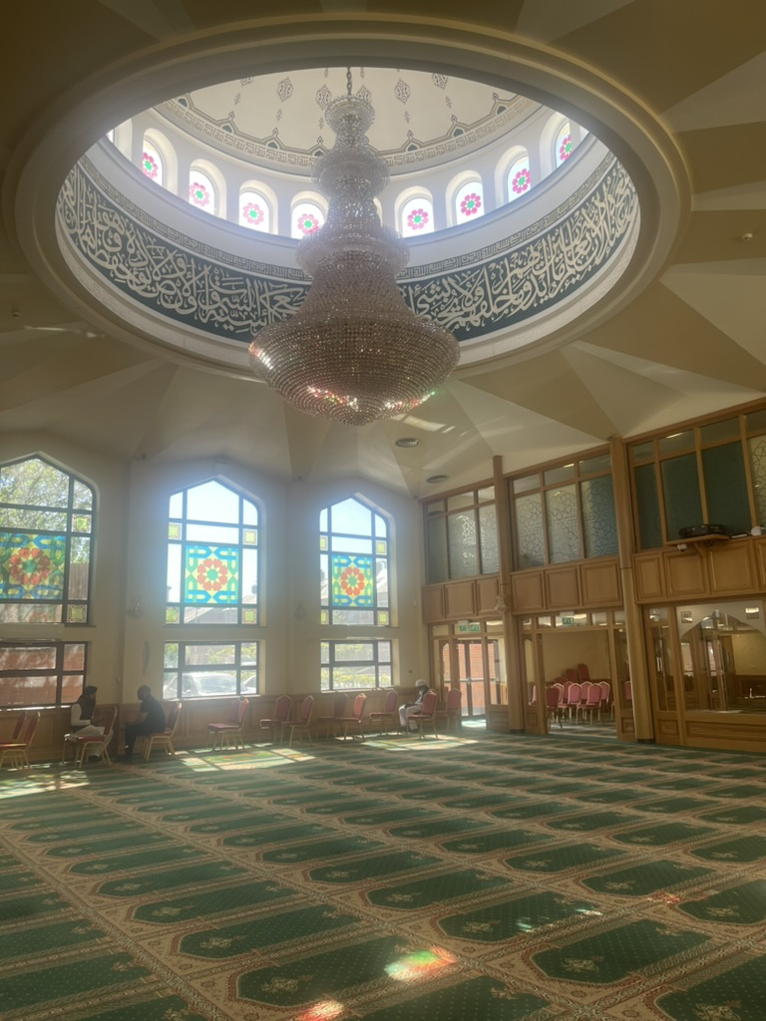
Announcements
Salah times this week inshallah; Fajr 5:30am, Zuhr 2pm, Asr 6:30pm, Maghrib 8:22pm, Isha 10:15pm
Please bring your children for prayers in the holidays.
Please donate sincerely and generously to Allah’s cause (£2075 last week).
Football this evening after Asr (6:45pm)

Slide 14
Announcements
Annual Mawlid al-Nabi Mahfil – Sunday 7th September 2025, after Zuhr. Please save this date now, thanks. Please also give sadaqa towards the mahfil thanks
Exercise sessions for elders on Mondays and Wednesdays, after zuhr
Jazakallah for clothes for the Ashton Community Fridge; no more for now

Slide 15
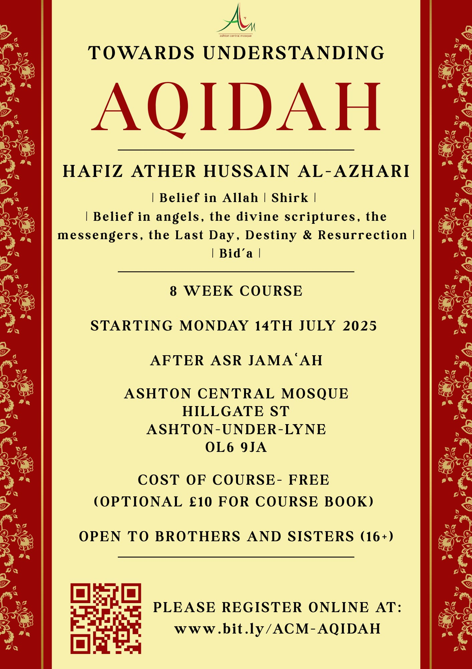
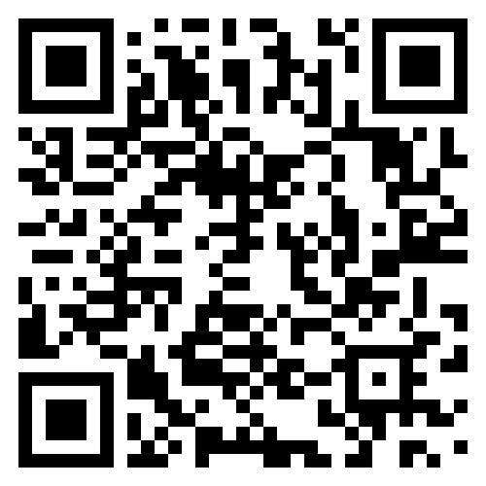
Announcements
Aqidah course for all
Classroom based teaching
Opportunities for questions
Sisters welcome
Please register (FREE)
Class VII this TUESDAY 26th August inshallah, after Asr.

