Slide 1

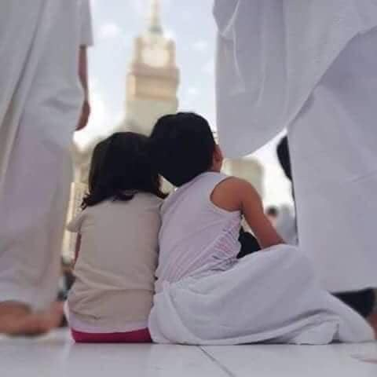
Suhba: good friends = good times
Jumu'ah Salah English Speech
Hafiz Ather Hussain al-Azhari
1:15pm-1:55pm
Ashton Central Mosque OL69JA

Slide 2

Friday – the day of salawāt

Slide 3
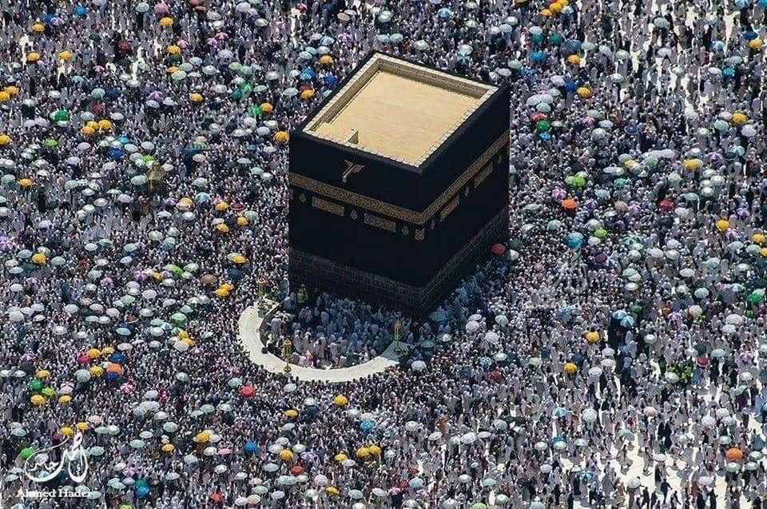
Man the “social animal”
Greek Philsopher Aristotle made an observation 2000 years ago; that man is a “social animal”.
What this means is that man cannot live alone; he has to interact and mix with others.
Islam accepts this. Additionally, our religion stresses that who you choose to be friends with is pivotal. It can make you or destroy you.
We call this suhba; the idea of picking the best friends and company in life.

Slide 4



Islam on good suhba (companionship)
Your own image depends on your suhba.
You are judged according to the company you keep.
Prophet Muhammad (peace be upon him) stressed this reality in many ahādith.
Fashion, haircuts, viewing habits and much more; all are shaped by the company you keep.

Slide 5


Islam on good suhba (companionship)
Your own development depends on your suhba.
In school, classes are organised with suhba in mind.
In sports, great care is taken to ensure sportsmen have the right training partners.

Slide 6

Islam on good suhba (companionship)
Suhba is so important that Islam asks us to seek good-companionship after death too!
The du’a to die in al-Madinah.
Imam al-Nawawi; always desire to be buried near the pious.
Hence why we have Muslim-only graveyards

Slide 7
Suhba is changing…
People prefer lower quality of Suhba, not higher
People prefer digital Suhba, not human Suhba
*We prefer friends over parents
*Pirs and Shaykhs are disregarded
*Celebrities and ’influencers’ are our best friends now
*We spend 4/5 hours a day on the phone
*We text, we don’t talk anymore
*We even take the phone to bed

Slide 8
Our friends; questions we need to ask
Are they making me more intelligent?
Are they friends that will embarrass me later?
Are they friends that think little of big sins?
Are they taking me away from good behaviour?

Slide 9
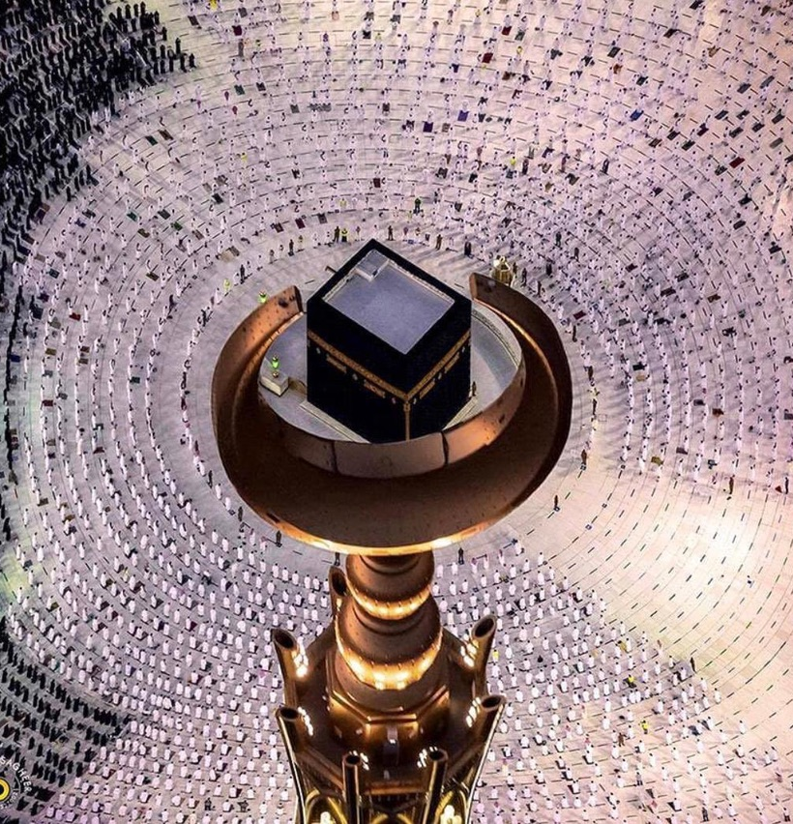
Conclusion
Surah al-Fatiha is the most recited Surah in the world. In essence, this Surah is a du’a for one thing; good suhba.
Seek good suhba and you are guaranteed good times. Best suhba is still the people of the masjid.

Slide 10

Announcements
Salah times stay the same this week; please bring your children for prayers in the holidays.
Please donate sincerely and generously to Allah’s cause (£2075 last week).
Football this evening after Asr (7pm)
Foodbank supported 364 families this week
Zakat Clinic: £9700 to 68 families

Slide 11
Announcements
Spaces still available for golf for sisters (organised by Muslim Golf Association). Deadline is August 4th inshallah.
Du’a maghfirah for Zarda Begum (sister of Zaved Bashir) and for the wife of Raja Ismatullah. May Allah grant them both Janna al-Fardaws, ameen.

Slide 12
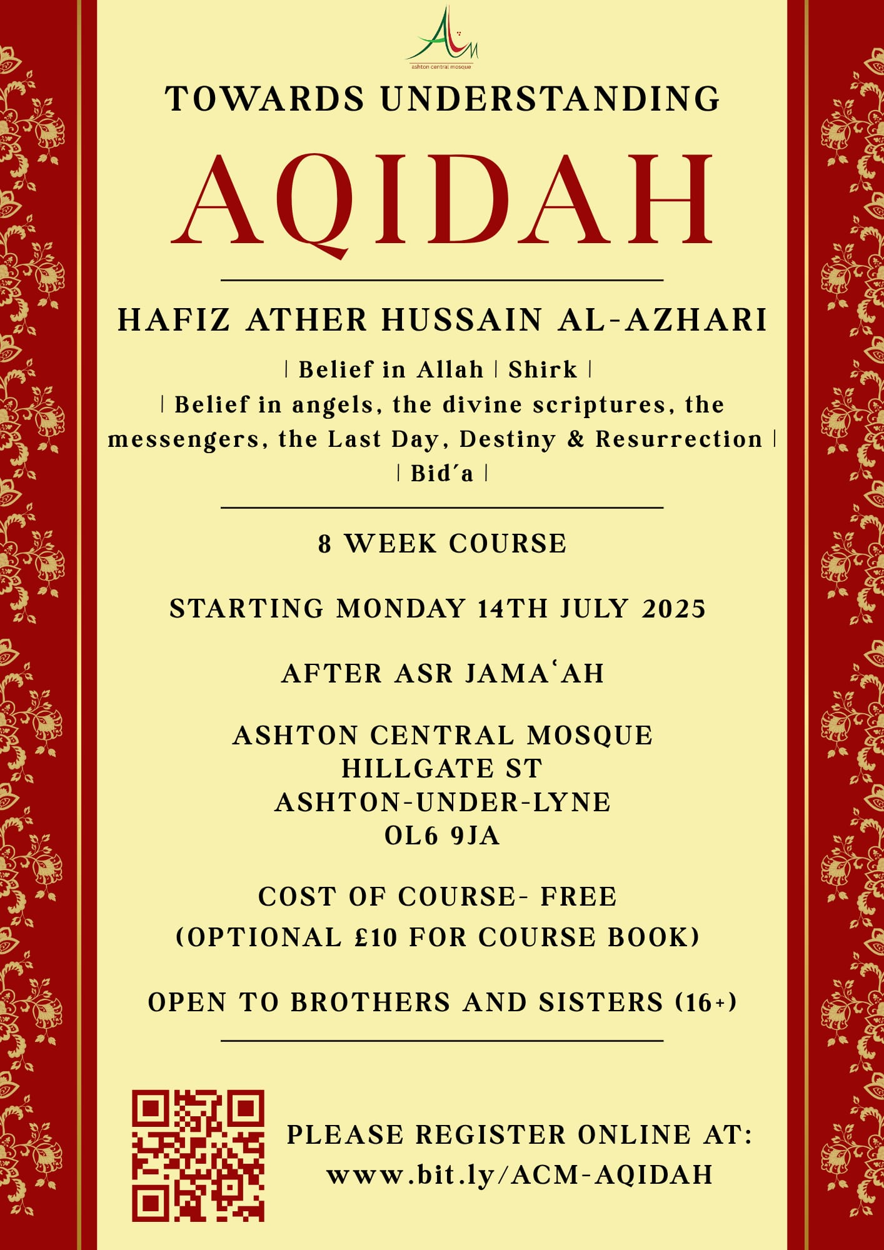
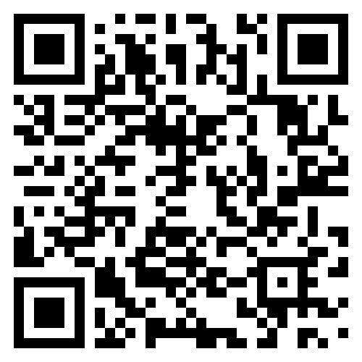
Announcements
Aqidah course for all
Classroom based teaching
Opportunities for questions
Sisters welcome
Please register (FREE)
Class IV this Monday 4th August inshallah, after Asr.

