Slide 1
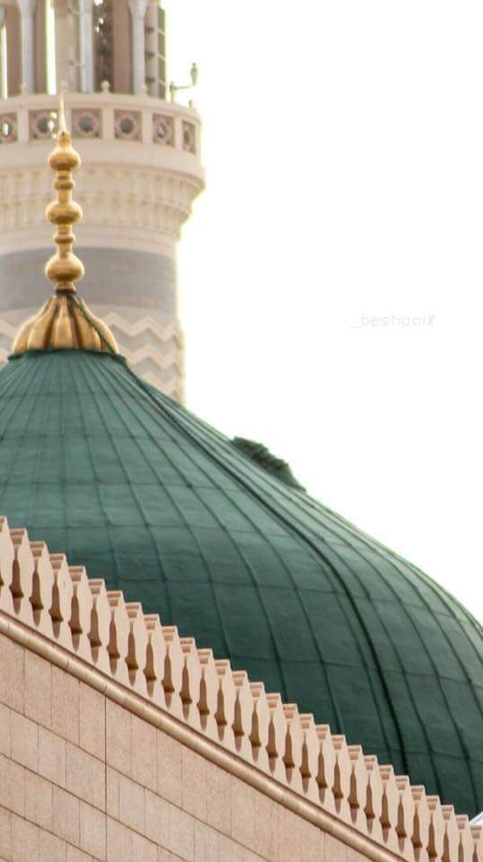

Prophet Muhammad ﷺ His impact on civilisation
Jumu'ah Salah English Speech
Hafiz Ather Hussain al-Azhari
1:15pm-1:55pm
Ashton Central Mosque OL69JA

Slide 2
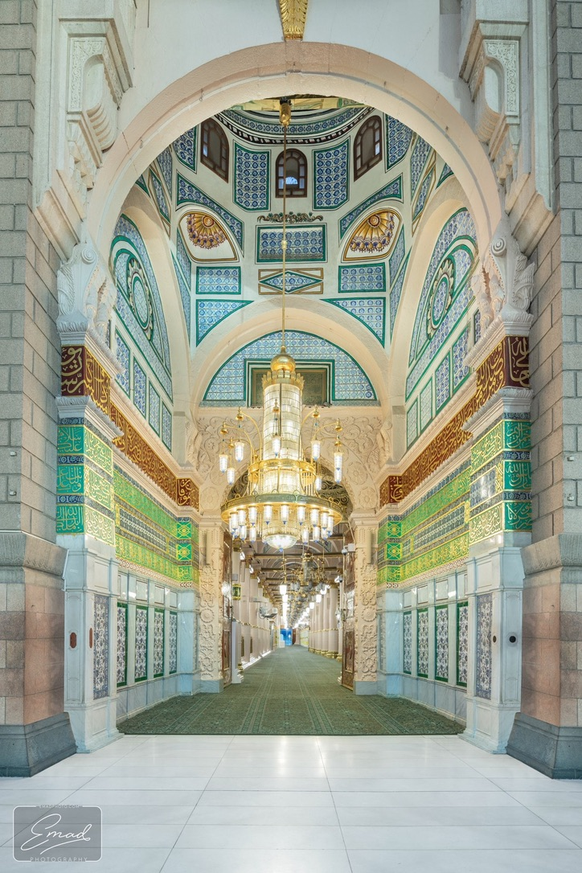
Friday – the day of salawāt

Slide 3
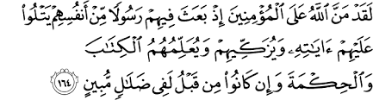
The favours of Allah
Allah doesn't expect you to thank him for all of his favours, not least because it is impossible.
However, Allah does expect you to remember his greatest favour, which is the sending of Prophet Muhammad ﷺ

Slide 4
Life without him ﷺ
The last part of this verse needs our attention.
Allah reminds us that without him (peace and blessings of Allah be upon him), we were utterly misguided and lost. It was Prophet Muhammad (peace and blessings of Allah be upon him) who introduced us to Allah and thus provided us with salvation.
On this basis, it is no exaggeration to state that Prophet Muhammad (peace and blessings of Allah be upon him) made the most impact on humanity. The purpose of this talk is to prove this.

Slide 5
How do you judge the impact of someone?
*How do you judge the impact of a teacher? Do you put him/her in an ‘Outstanding’ school?
*How do you judge the worth of a good football manager? Do you make him manage a good or bad team?

Slide 6
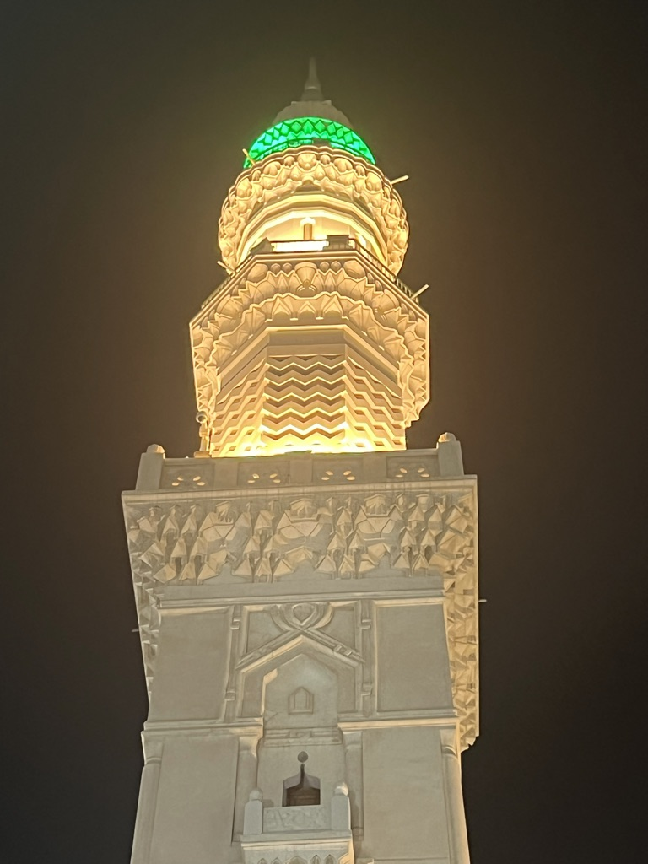
Judging impact
Because other factors may come into play, you must judge the impact of an individual by putting him in a difficult setting, and then judge what the difference is before and after.
‘Compare & contrast’

Slide 7
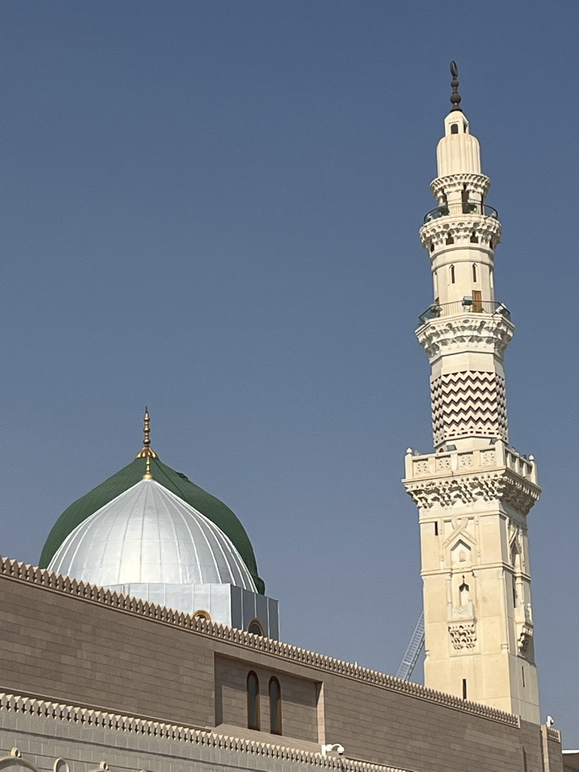
Judging Prophet Muhammad’s impact ﷺ
Prophet Muhammad ﷺ was the most impactful individual ever to have existed.
To prove this, Allah did not send him to a developed civilization.
In fact, Prophet Muhammad ﷺ was sent to the most underdeveloped.
In a short period of 23 years, he ﷺ turned this community into the most developed.
More importantly, this impact is visible with us today too.

Slide 8
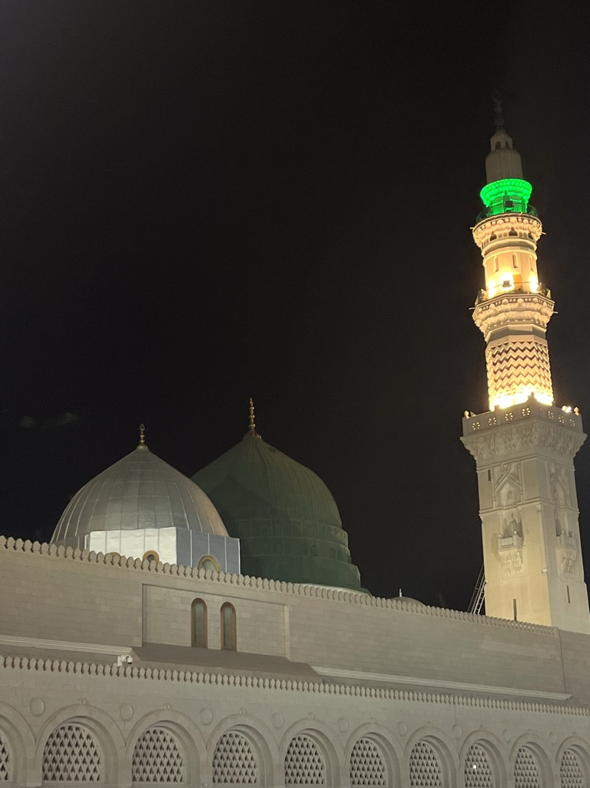
Arab society before his ﷺ appearance
The worse for its time
Burying daughters alive
No concept of justice
Worse beliefs – worship of idols & stones
Abundance of vice and immorality

Slide 9
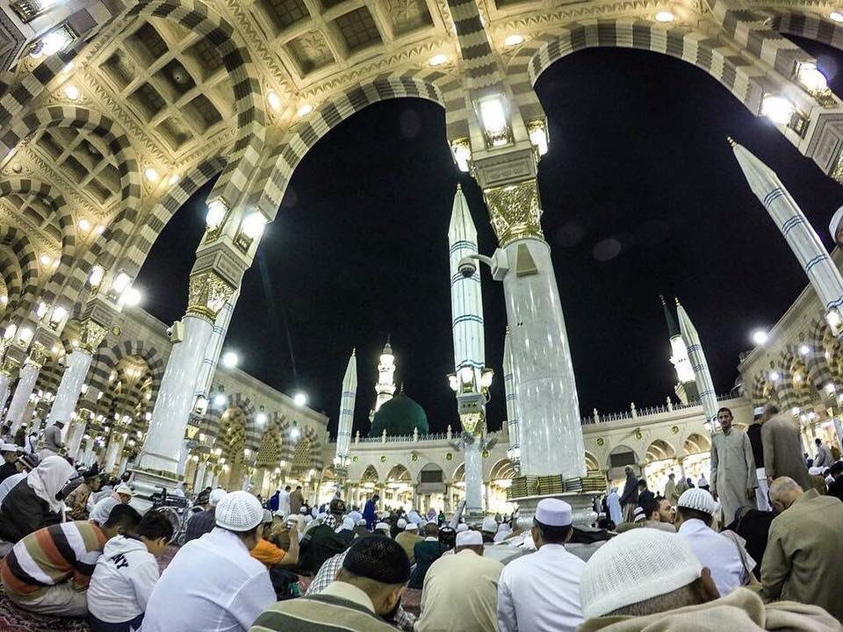
What did Prophet Muhammad ﷺ do?
He gave humanity to humans.
He championed women’s rights in a time where it was unheard of.
He instilled tawhid into the hearts of the entire Peninsula
He changed the hearts of his community forever

Slide 10
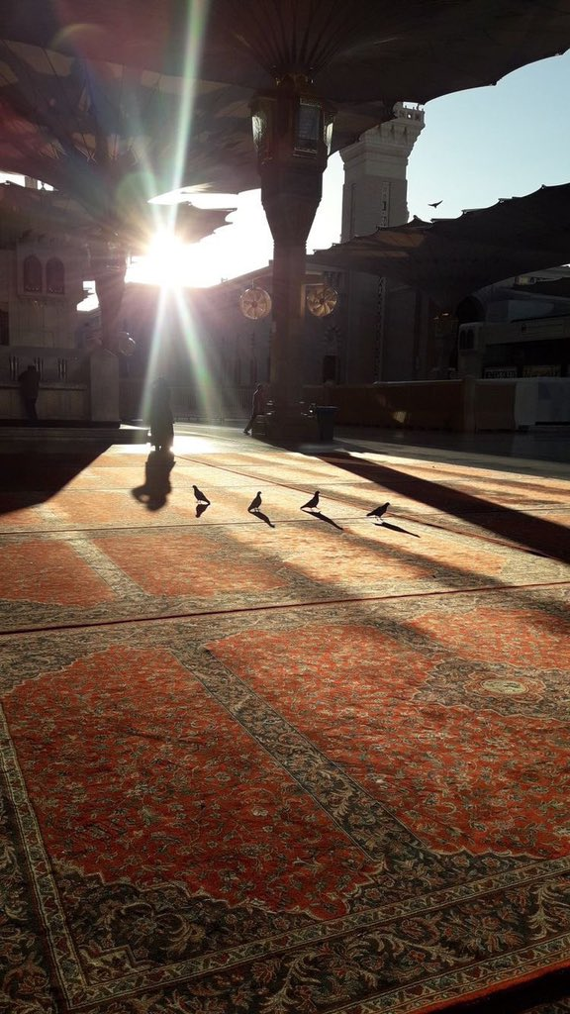
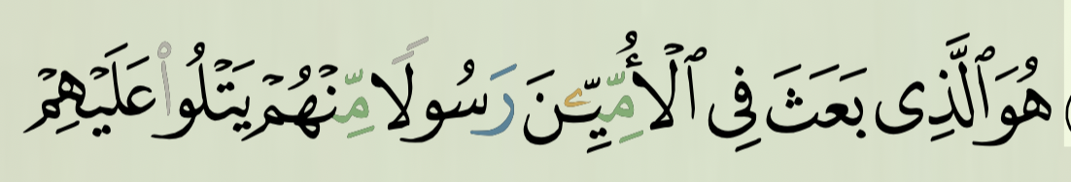
An ignorant society
Before the Messenger ﷺ appeared, the Arabs were ignorant. Very few could read.
Hence why the Qur’an describes his people as ‘Ummiyyin’.

Slide 11
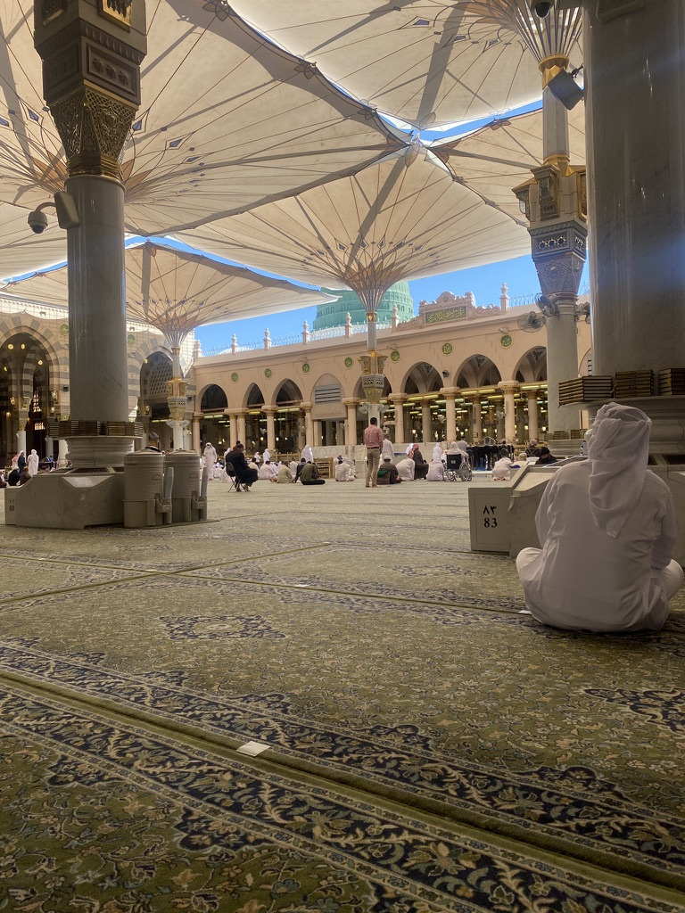
A learned society…
In a short period of time, the Messenger ﷺ turned them into highly educated people, who loved teaching and learning.
Muslims became world leaders & pioneers in every field of knowledge.
This was purely thanks to the impact of our Beloved ﷺ

Slide 12
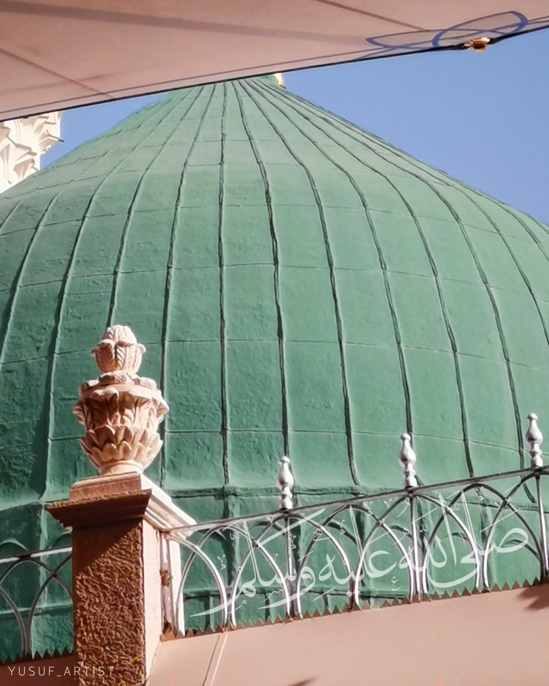
Prejudice behaviour
The Arabs were very prejudiced. Racism was rampant in society
Slavery was common; no rights were given to slaves and were treated worse than animals.

Slide 13
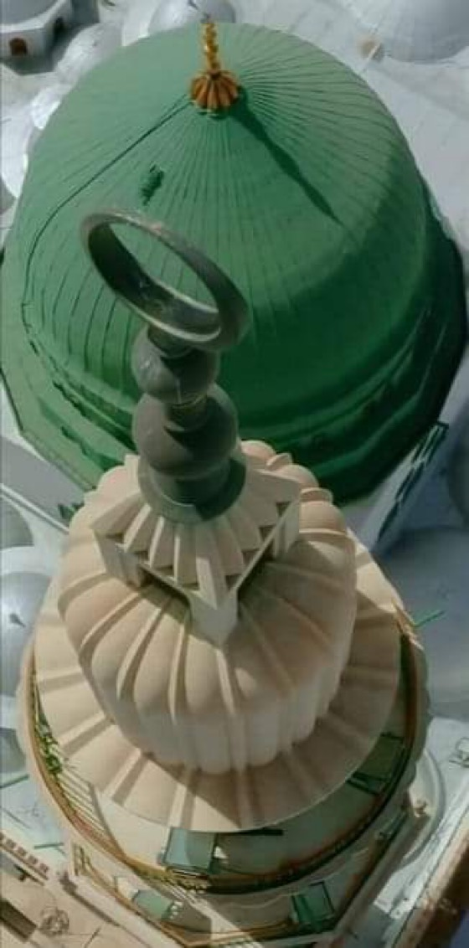
Humanity restored…
In a short space of 23 years, the Messenger ﷺ of Allāh gave dignity to all of Allah’s creations. Even animals.

Slide 14
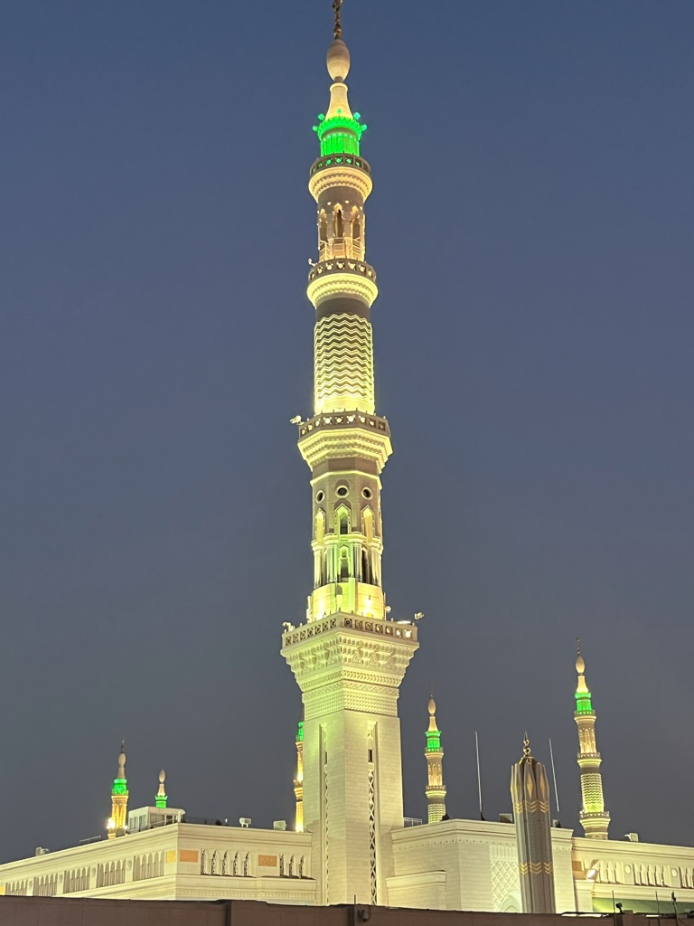
Al-Madina al-Munawwara
To show the impact of the Messenger ﷺ , Allah made him migrate to al-Madina.
Prior to his appearance there, it was called Yathrib (place of illness)
People got ill by merely breathing the air.
But when he appeared, the city became the pure and enlightened city.
This was purely thanks to him.

Slide 15
Lasting impact
His impact has not ceased. In fact – day by day – we are witnessing more of his intelligence, wisdom and pearls of guidance.
Animal rights
The Pandemic
The environment
Mental illness

Slide 16
Purpose of the Mawlid
Muslims
Mawlid
Thanking Allah for this great favour
Sending Salawat upon him
Worship at home & in the mosque
Remembering his contributions
Lift our spirits
Muslims getting together
Notes:
Reuters
https://twitter.com/husnainyaqoob10/status/1579807855741669377?s=46&t=CpwgGRfNJIWTAEOrcSONwA
Malaysia
https://twitter.com/HusnainYaqoob10/status/1579587060662702080?s=20&t=xdYKgzeGxalbd_l2ikuCxQ
Kurdistan
https://twitter.com/8Sayyida/status/1578867347645173761?s=20&t=xdYKgzeGxalbd_l2ikuCxQ
Palestine
https://twitter.com/5Pillarsuk/status/1579048481922379778?s=20&t=xdYKgzeGxalbd_l2ikuCxQ

Slide 17
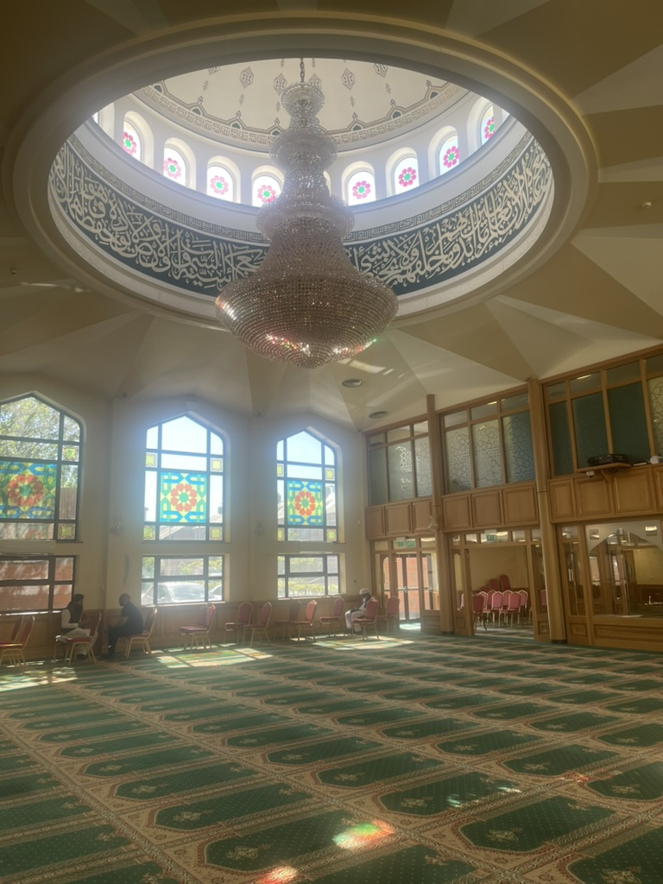
Announcements
Salah times this week from Saturday onwards:
Fajr 5:45am
Zuhr 2:00pm
Asr 6:15pm
Maghrib 8:05pm +-
Isha 9:45pm
Please donate sincerely and generously to Allah’s cause (£2380 last week).
Football this evening after Asr (630pm)
Ladies Mawlid after Zuhr (2pm) tomorrow Inshallah

Slide 18
Announcements
Annual Mawlid al-Nabi Mahfil at Ashton Central Mosque – Sunday 7th Sept (after zuhr); donations welcome for langhar sharif
Du’a maghfira for Brother Amir’s (Chilli Pickle) mother. May Allah grant her Janna al-Fardaws, ameen.
Du’a Sihhah for Dr Akram’s sister (operation today)

Slide 19
Madrassa System – the bare facts
The only time our children get guaranteed time in the mosque is the madrassa years.
It is the same time when they need most education and nurturing; what they learn now stays with them forever.
ACM’s Madrassa System is going through changes to meet your child’s demands….

Slide 20
Madrassa System – our services
Education from 5 +
Dedicated Hifz Class
Arabic language classes
Lessons on essential life skills such as:
Islam on mental health
Islam and money
Gender roles
Staying positive

Slide 21
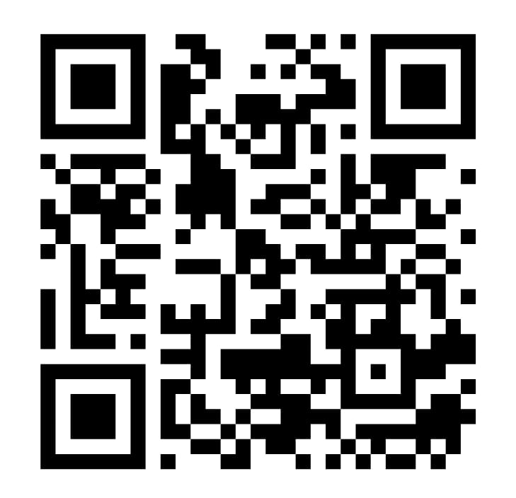
Madrassa System – please register
If your child is between 12-17 (and is not currently in madrassa), please register them for these classes.
https://forms.gle/gMPzFNFrQzomqYd97

